Slide 1








Presenter name
What
is
Depression
?
An introduction to understanding depression

Slide 2



What’s
inside
About
depression
Depression
vs. sadness
Types of
depression
Signs and symptoms
Diagnosis
Treatment
Offering
support
Where to
get help

Slide 3

About depression
Provide a formal definition from a credible source (e.g., World Health Organization).
Break it down into simple, clear language that your audience can easily understand.

Slide 4
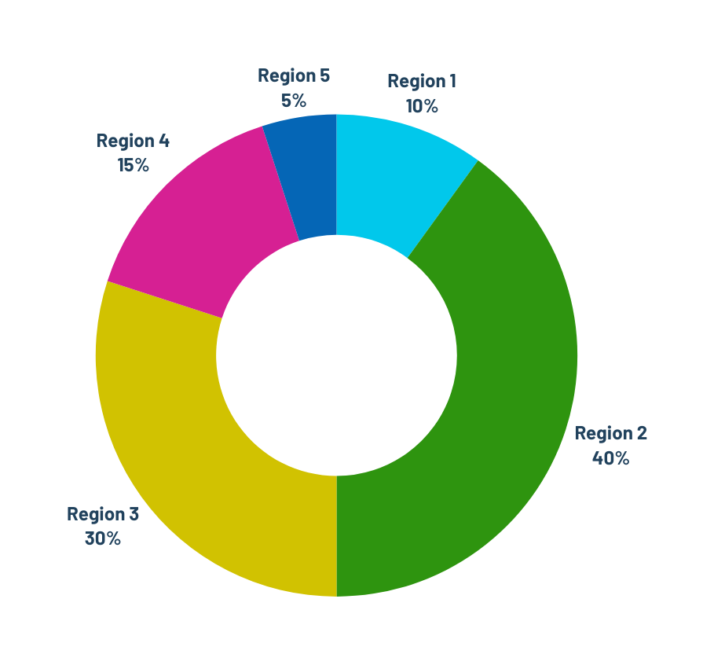
Global
cases of depressive disorder
Include a chart showing the global impact of depression. Explain how the data connects to the topic and why it’s important for learners to understand.

Slide 5
How does
depression
differ from
sadness?
Clinical depression
Sadness
  Include a definition for this term.
  Highlight duration differences.
  Emphasize cause and intensity.
  Describe how it impacts the person involved.
  Include a definition for this term.
  Highlight duration differences.
  Emphasize cause and intensity.
  Describe how it impacts the person involved.

Slide 6
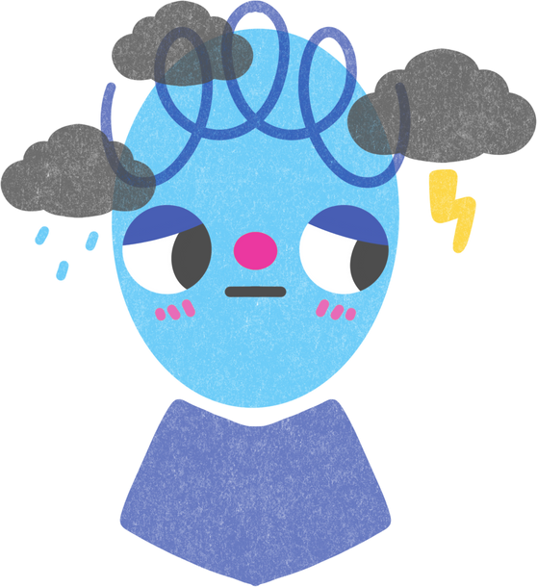

Major depression
Describe its defining characteristics.
Common types of depression
Persistent
depressive order
Describe its defining characteristics.

Slide 7


Common signs and symptoms
Emphasize that depression looks different for everyone. Include a reminder that if someone feels unsafe or overwhelmed, they should reach out to a counselor, helpline, or trusted adult.
1
2
3
Symptom 1
Symptom 2
Symptom 3
Supporting details here
Supporting details here
Supporting details here

Slide 8


Question
goes here
Learning
Option 1
check
Option 2
Add a multiple-choice question to test understanding.
Option 3
Option 4

Slide 9

Initial screening
How is depression diagnosed?
Supporting details here
Clinical interview
Supporting details here
Use this slide to outline the steps a mental health professional may take to assess depression. Include what each step involves and what typically happens next.
Diagnostic criteria
Supporting details here

Slide 10
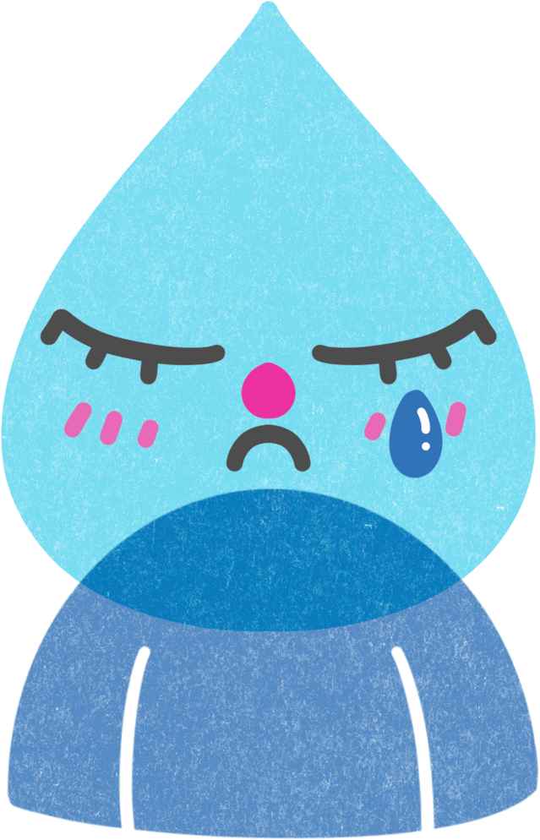
How is depression treated?
Explain the main approaches to managing depression.
Emphasize that recovery is possible and help is available.
Psychotherapy
Medication
Support system
Explain how this helps manage depression.
Explain how this helps manage depression.
Explain how this helps manage depression.

Slide 11


How to show support
Encourage
professional help
Supporting details here
Another actionable
step here
Supporting details here
Another actionable
step here
Supporting details here

Slide 12

Review
What is depression?
Explain the key concepts covered here.
What are the common signs and symptoms?
Explain the key concepts covered here.
How is depression diagnosed and treated?
Explain the key concepts covered here.

Slide 13

Where
to
get
help
Organization here
Organization here
Organization here
Helpline or number here
Helpline or number here
Helpline or number here

Slide 14


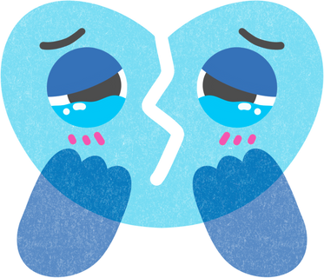
Resource Page
  Use these in your presentation. Delete or hide this page before presenting.
Fonts
Elements
This presentation template
uses the following free fonts:
TITLES:
Vollkorn
BODY TEXT:
Barlow
You can find these fonts online too.
Colors
#01C8EB
#D1C201
#D62093
#2E940F
#0566B6

Slide 15


Credits
  This presentation template is free for everyone to use, thanks to the following:
Pexels, Pixabay, Sketchify
  for this presentation template
  for the photos, graphics, and elements
Happy designing!

