Slide 1



Personal Finance 101
Grade 10
Elective Subject

Slide 2


Budgeting
Managing your money wisely
What you’ll learn
Debit vs credit
Knowing the difference
Spending and saving
Smart choices, long-term gains

Slide 3

Would you rather have...
$20 million years from now?
$10 million now?
or
Talk about your answer with a peer.

Slide 4


Budgeting
Creating a budget is key to having a healthy financial lifestyle. It helps you to:
Plan your spending
Afford the things you need
Save for the things you want
Avoid getting into debt
Build confidence with money

Slide 5


Budgeting
Take a look at the sample tables below. How much is left over, and where could you make changes to stay within budget?
Total Income
Allowance | $30
Part-time job | $20
Total | $55
Total Expenses
School Supplies | $15
Transportation | $15
Snacks | $25
Total | $55

Slide 6

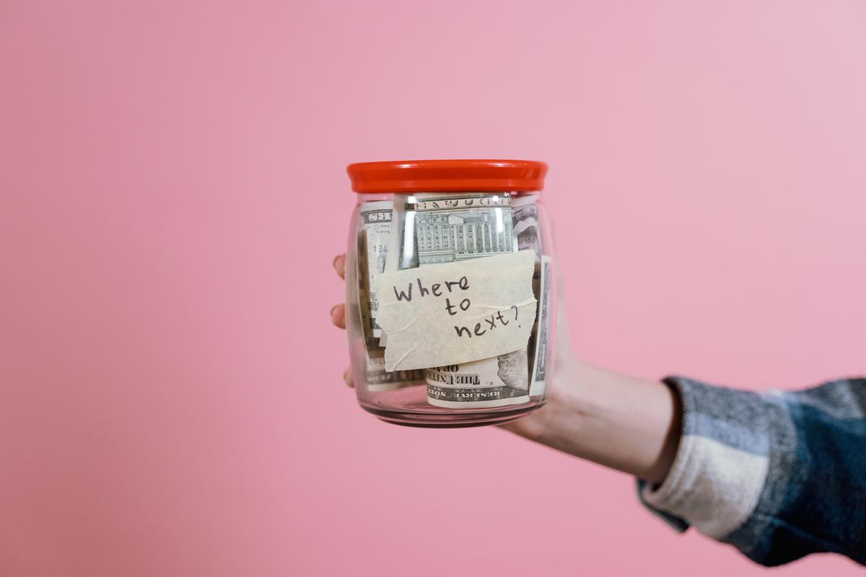
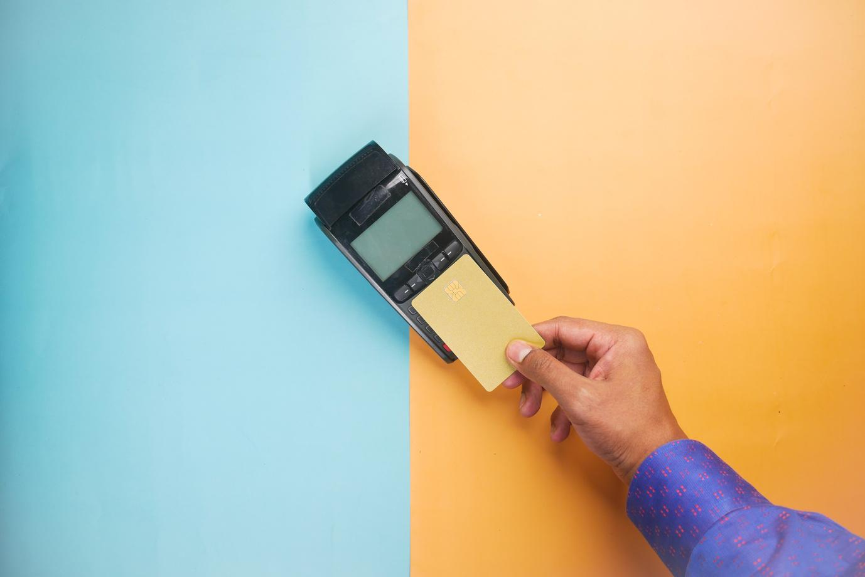

Debit
Debit vs. credit
Uses your own money from your bank account
How are these two different?
Credit
Uses the bank’s money, which you have to pay back later

Slide 7
 | Advantages | Disadvantages
Debit | Avoids interest or fees when used responsibly | Requires money in your account
 | Prevents you going into debt | Offers limited protection against fraud
Credit | Enables you to buy what you need, when you need it | Can lead to debt if not paid off on time
 | Allows payment in installments | May have high interest rates
Debit vs. credit
How are these two different?

Slide 8
Quick Check
What would you do if someone gave you $1,000 today?
Would your answer change if you had to make that money last a whole week?

Slide 9


Spending and Saving
Saving a little each month helps you handle the unexpected, like a surprise trip to the doctor or a last-minute move.

Slide 10
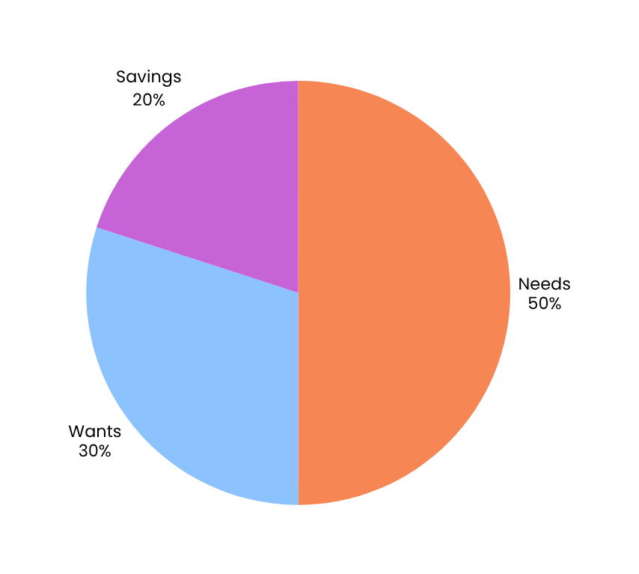
Spending and Saving
Wondering how much to save?
The 50-30-20 rule is a good place to start:
50% for needs, 30% for wants, and 20% for savings.

Slide 11
Money Management Tips
Track your spending
Save a little, often
Write down everything you spend, even small purchases
Set aside even small amounts from allowance, gifts, or part-time jobs.
Create a budget
Think before you spend
Make a weekly or monthly plan for your money, and stick to it.
Ask, “Do I really need this? Can I afford it?”

Slide 12
1-week spending tracker challenge
Track your daily spending for 7 days
Create a chart to show your spending by category
Then answer:
  Where did most of your money go?
  What will you change next week?
  What surprised you?

Slide 13
Resource Page
Use these in your presentation. Delete or hide this page before presenting.
Fonts
Design Elements / Icons
This presentation template
uses the following free fonts:
TITLES:
Poppins Semibold
BODY TEXT:
Poppins Light
You can find these fonts online too.
Colors
#F68654
#8CC3FF
#ED8DFD
#3A9680
#C6EB97

Slide 14



Credits
  This presentation template is free for everyone to use, thanks to the following:
Pexels, Pixabay, Sketchify
  for this presentation template
  for the photos, graphics, and elements

