Slide 1

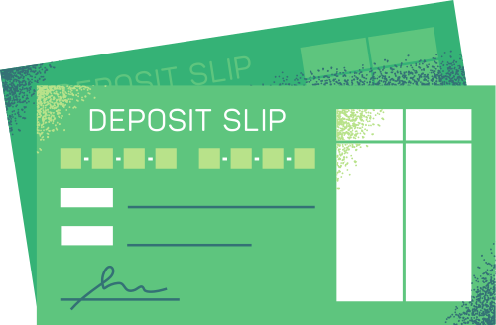
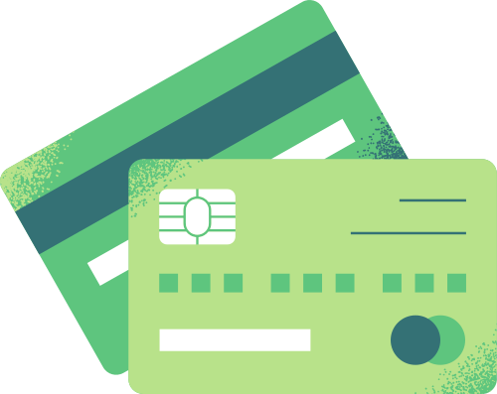


Difference Between
Saving and Investment
Prof. Dennison Hastings | Leonton University

Slide 2
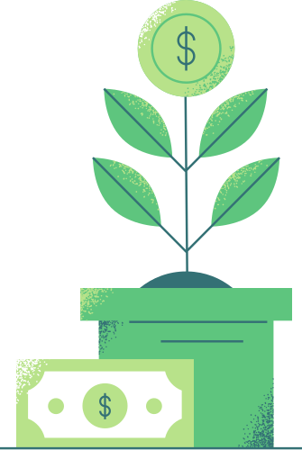
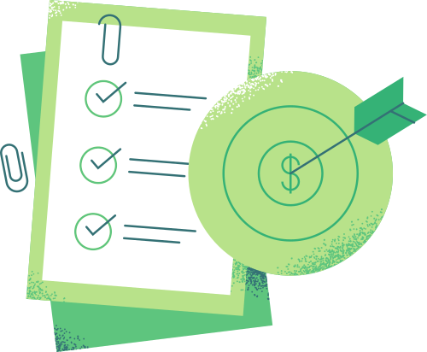

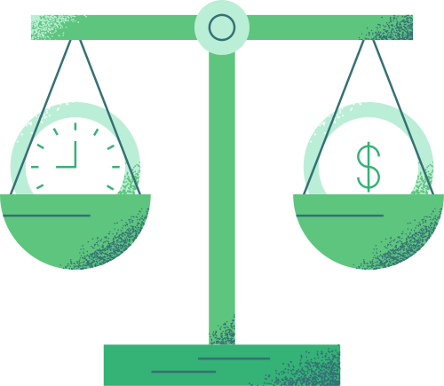
What’s inside
Saving vs. Investing
Balancing Savings and Investment
Why
invest
Tips on
investing
Learn the difference between saving and investing
Discover some tips on how to balance saving and investing
Explore the benefits
of investing
Get started with practical tips on investing

Slide 3

Are you a saver or a spender?
Imagine this: You just found $100 on the ground.
What would you do with it? Would you stash it in your
wallet, spend it immediately, or try turning it into $200?

Slide 4


Saving vs. Investing
The difference between saving and investing
Savings
Investing
Setting aside money, typically in a bank account, for
future use
Involves buying assets that have the potential for higher returns

Slide 5
Saving vs. Investing
 | Savings | Investing
Type of goal | Often for short-term goals, such as saving for a large purchase or emergencies | May help reach long-term goals, such as planning for retirement or paying a child’s education
Time it takes to access funds | Easily accessible | Often takes a longer time to access
Risk involved | Involves minimal risk and funds are often strictly regulated | Does not always guarantee a return and losing the invested funds is possible
Earning potential | Generally low | Has higher potential return compared to a savings account

Slide 6
How much should you save vs. invest?
A good starting point is saving 20% of your income.
After building your emergency fund, begin allocating any extra funds toward investments.

Slide 7
Financial goals for
saving vs. investing
Saving
Investing
emergency fund
vacation or travel
retirement
child’s education
business
new gadgets
car down-payment
property taxes
wealth growth
home ownership

Slide 8
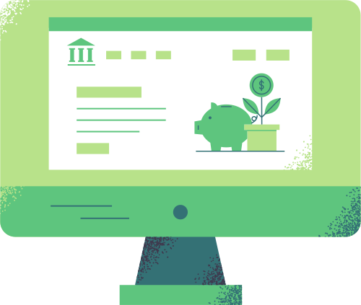
Why should you invest?
  Investing helps you stay ahead of rising living costs caused by inflation
  Long-term investments also offer the potential for compound interest and significant wealth growth

Slide 9
The risk-return tradeoff
Investments differ in their potential returns and market risk levels
Risk
Low risk
Low return
The possibility of an investment losing value
Return
High risk
Higher potential return
Return
Profit or gain earned from an investment
Risk

Slide 10

Tips when starting to invest
Start by building an emergency fund
Setting aside 3-6 months’ worth of living expenses is recommended.
Explore how to allocate your assets wisely
Balance risk and security by deciding how much to allocate to stocks, bonds, and other investments based
on your financial goals and risk tolerance.
Diversify your investment portfolio
Owning a mix of investments can protect your money in case of market downturns.

Slide 11
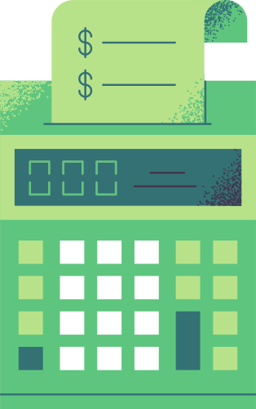

Review
Savings vs. Investing Savings involve setting aside money for short-term goals, while investing focuses on buying assets with the potential for higher returns. | Balancing saving and investing A good starting point is to save 20% of your income and build an emergency fund before investing your extra funds. | Tips when investing When investing, consider your risk tolerance and ensure you diversify your portfolio to manage risk effectively.

Slide 12
Explain investing using analogies
Investing can be intimidating for beginners. Think of a fun and simple analogy to explain investment terms and concepts, and present it creatively on a poster.

Slide 13
Got questions?
Email
hello@reallygreatsite.com
Phone
123-456-7890

Slide 14





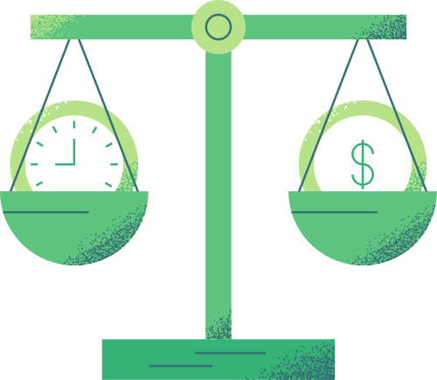

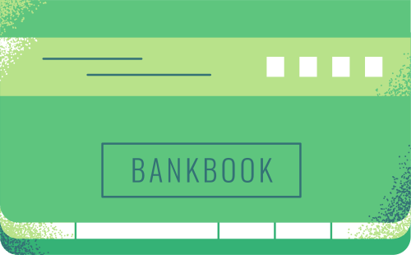
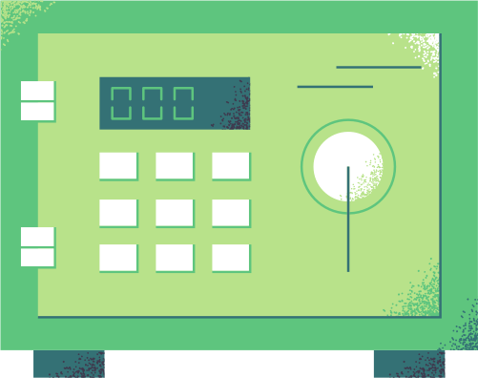

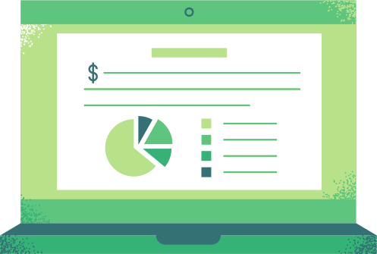


Resource Page
  Use these in your presentation. Delete or hide this page before presenting.
Fonts
Design Elements
This presentation template
uses the following free fonts:
TITLES:
SOURCE SERIF PRO
HEADERS:
SOURCE SERIF PRO
BODY COPY:
OPEN SANS
You can find these fonts online too.
Colors
#BBEED6
#B8E28A
#5EC57E
#347175
#000000

Slide 15

Credits
  This presentation template is free for everyone to use, thanks to the following:
Pexels, Pixabay,
Sketchify
  for the presentation template
  for the photos, graphics, and elements
  Happy designing!

