Slide 1



Water Baptism
SLIDES

Slide 2


Table Of Contents
Meaning of Baptism
  Briefly elaborate
  on what you want
  to discuss.
About Baptism
Symbols of Baptism
  Briefly elaborate
  on what you want
  to discuss.
  Briefly elaborate
  on what you want
  to discuss.

Slide 3

About Baptism
  Briefly elaborate on what you want
  to discuss.

Slide 4


Welcome To Presentation
  I'm Raina, and I'll be sharing with you my beautiful ideas. Follow me at @reallygreatsite to learn more.

Slide 5


About Baptism
Definition
  Baptism is defined as a Christian sacrament marked by ritual use of water and admitting the recipient to the Christian community.
Purpose
  The purpose of baptism is to be inducted into a community of believers, or the Christian community.

Slide 6

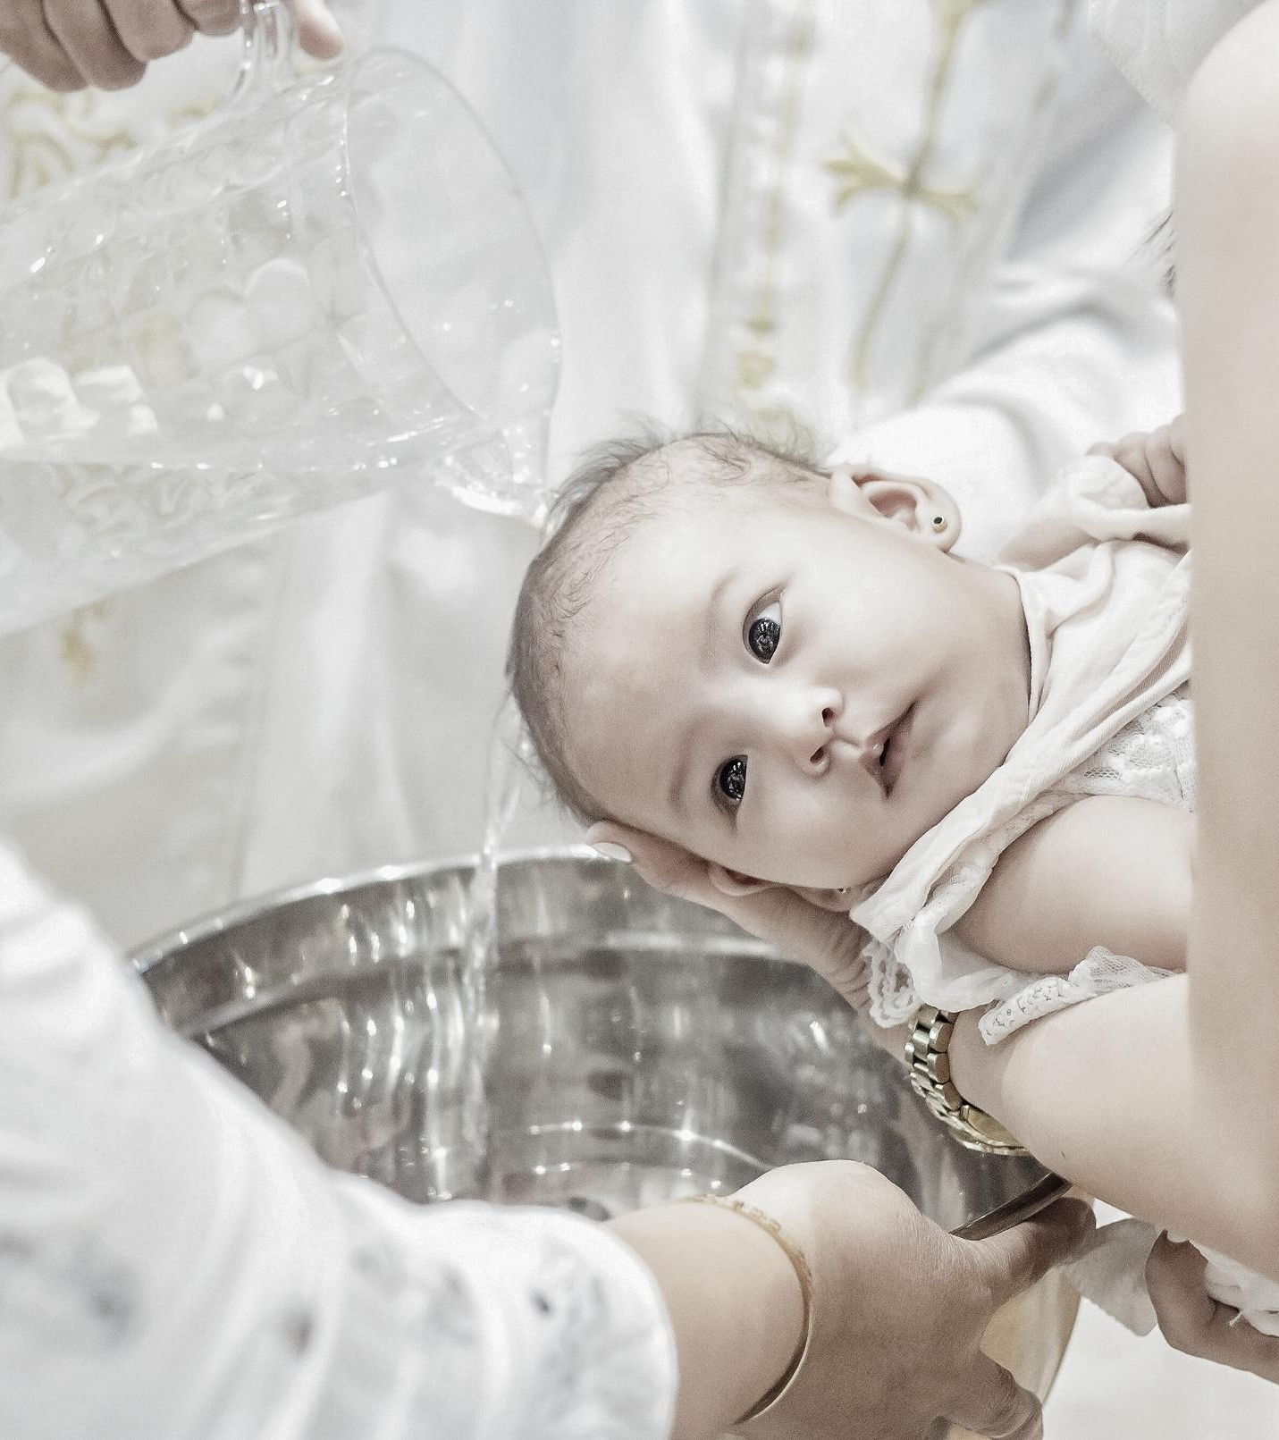
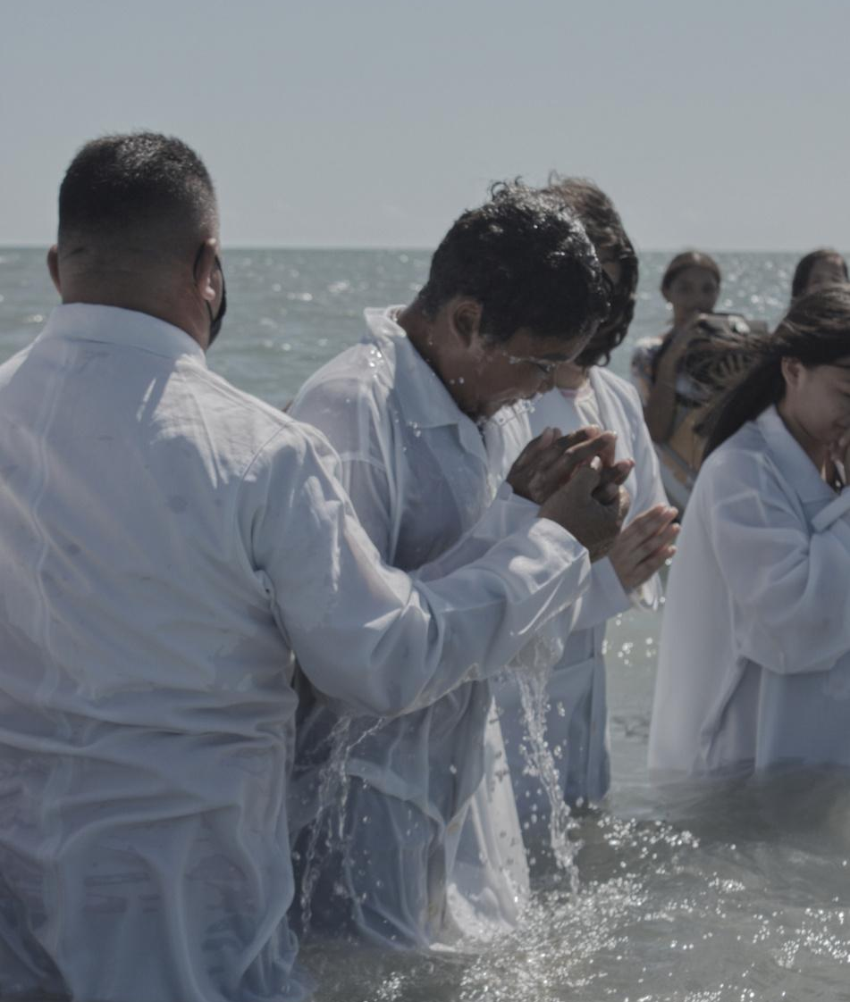
Gallery Image
  What can you say about your projects? Share it here!

Slide 7

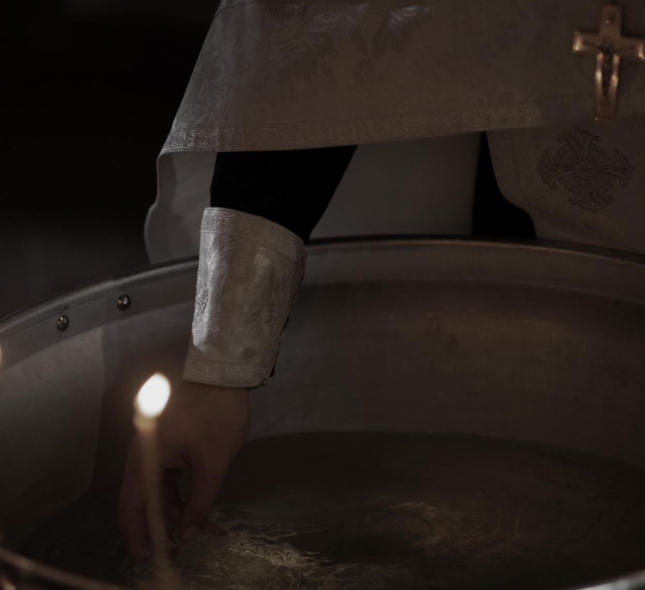

Write Your Idea
Add a main point
Add a main point
Add a main point
  Briefly elaborate on what you want to discuss.
  Briefly elaborate on what you want to discuss.
  Briefly elaborate on what you want to discuss.

Slide 8

Write an original
statement or
inspiring quote
— Include a credit, citation, or supporting message

Slide 9
Meaning of Baptism
  Briefly elaborate on what you want
  to discuss.

Slide 10
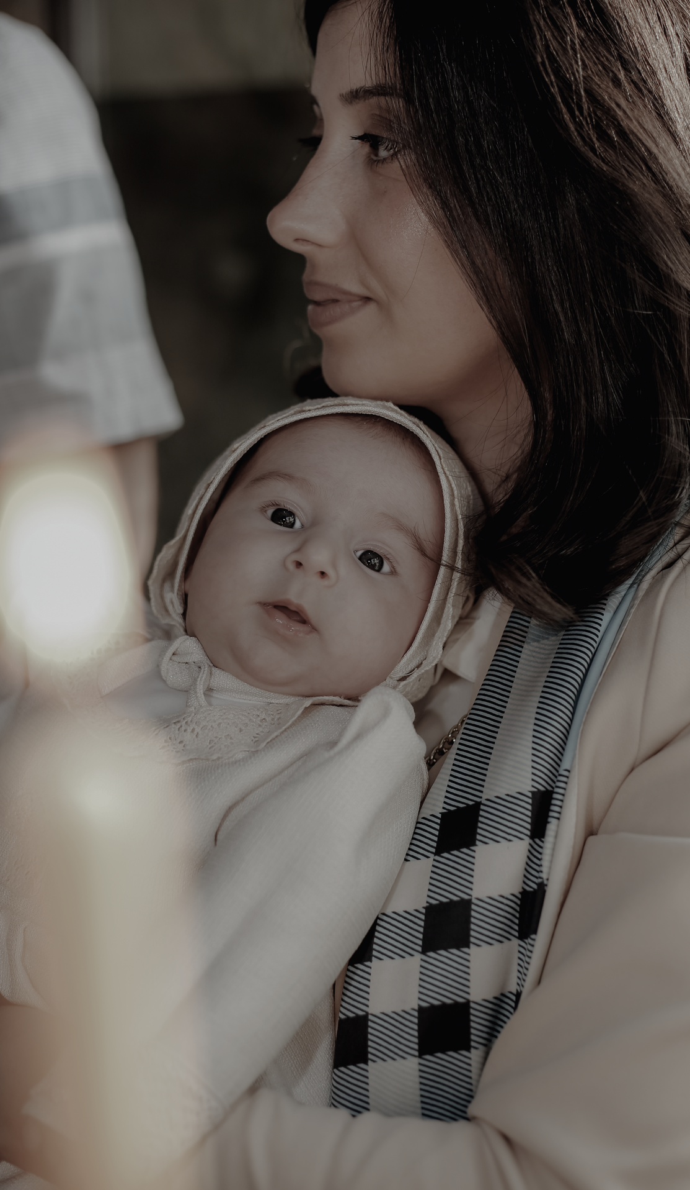
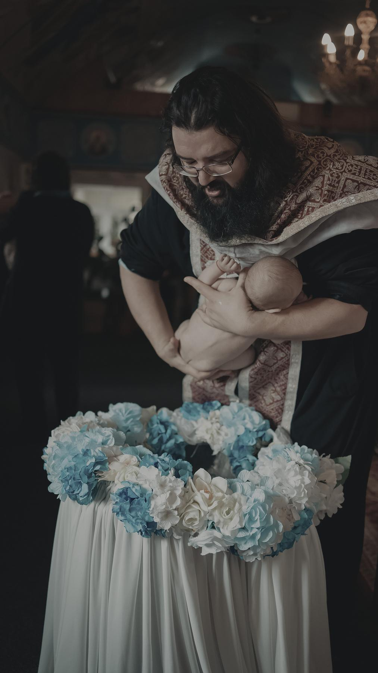

Don't you know that all of us who were baptized into Christ were baptized into his death? We were therefore buried with him through baptism into death in order that, just as Christ was raised from the dead through the glory of the Father, we too may live a new life.
Romans 6:3-4
  Apostle Paul

Slide 11



How Baptism Relates to Jesus
  It means we have turned from the old life of sin to a new life in Jesus Christ.
  It means we are publicly identifying with Christ’s death, burial, and resurrection.
  It means we are openly joining the ranks of those who believe in Christ.

Slide 12
Symbols of Baptism
  Briefly elaborate on what you want
  to discuss.

Slide 13
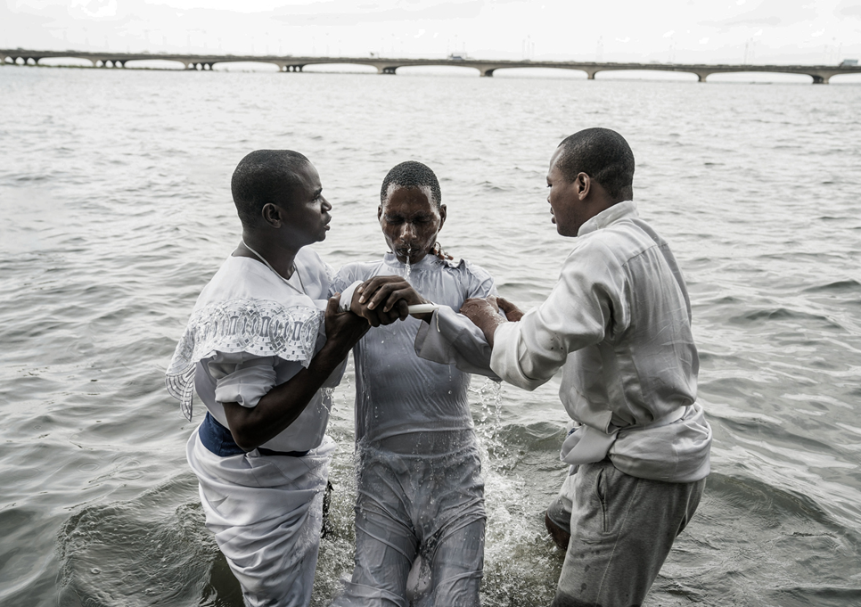
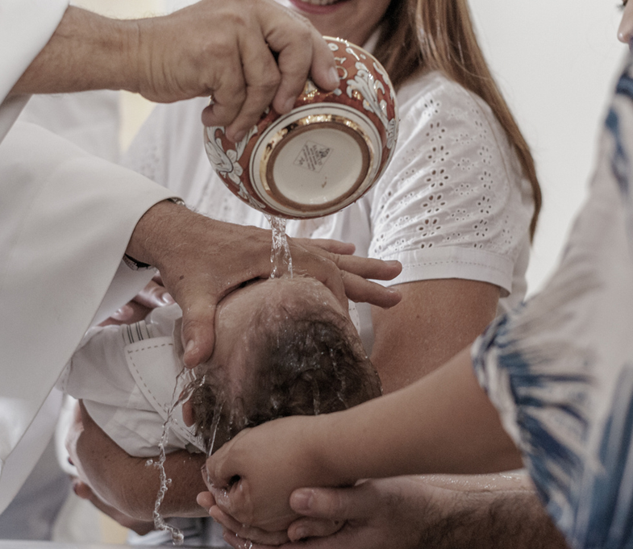



Some of the Symbols of Baptism
Fish
Water
Baptismal font
  A single fish represents a baptized person, a group of fish represents the community of believers, and a net represents the Church, which keeps the members together and protects them
  A seashell is sometimes used to cup and pour the water during baptism
  The baptismal font is a large basin, usually placed on top of a pillar or stand, but it may emanate from the floor.

Slide 14


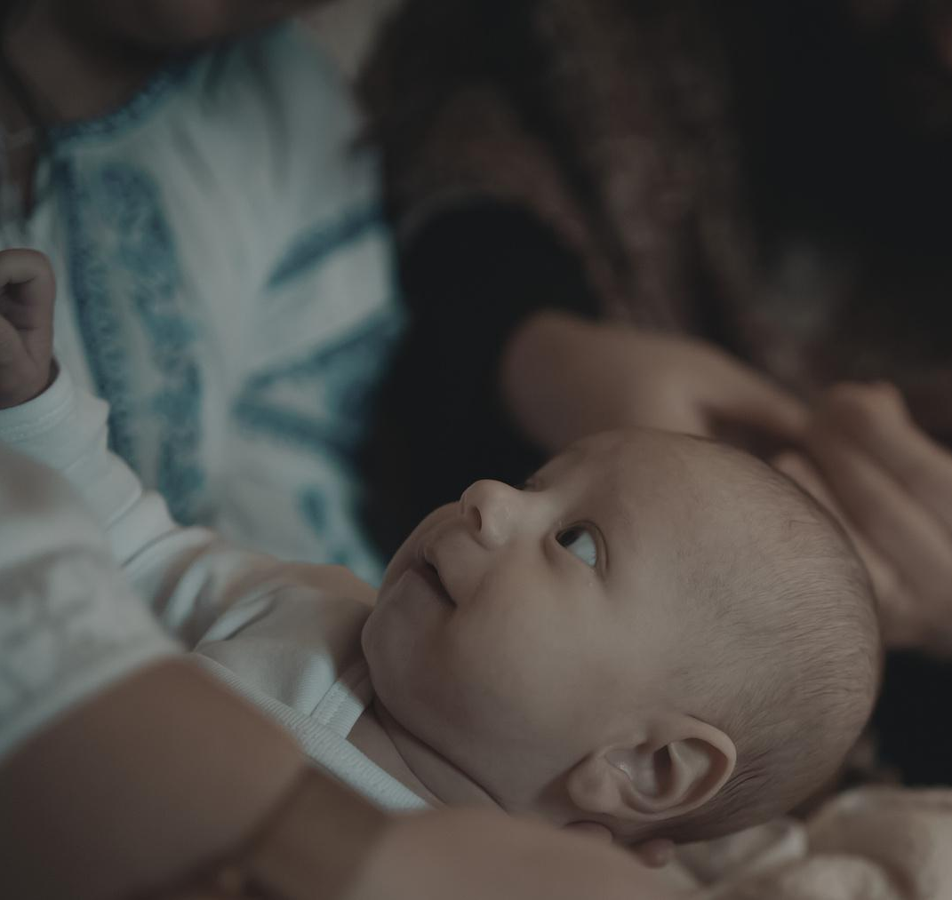
Write Your Idea
Add a main point
Add a main point
Add a main point
  Briefly elaborate on what you want to discuss.
  Briefly elaborate on what you want to discuss.
  Briefly elaborate on what you want to discuss.

Slide 15


World Map Report
Step One
Step Two
  Presentations are
  communication tools
  Presentations are
  communication tools
Step Three
Step Four
  Presentations are
  communication tools
  Presentations are
  communication tools

Slide 16

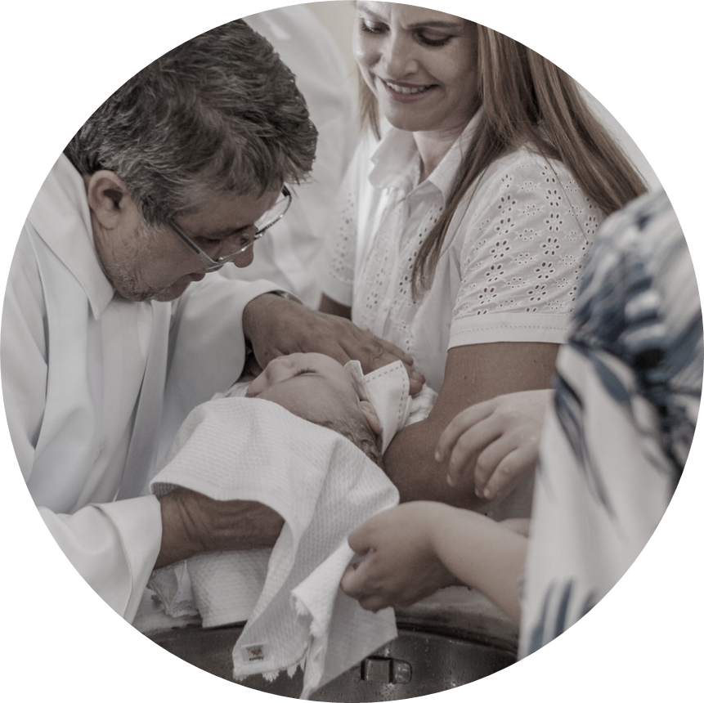
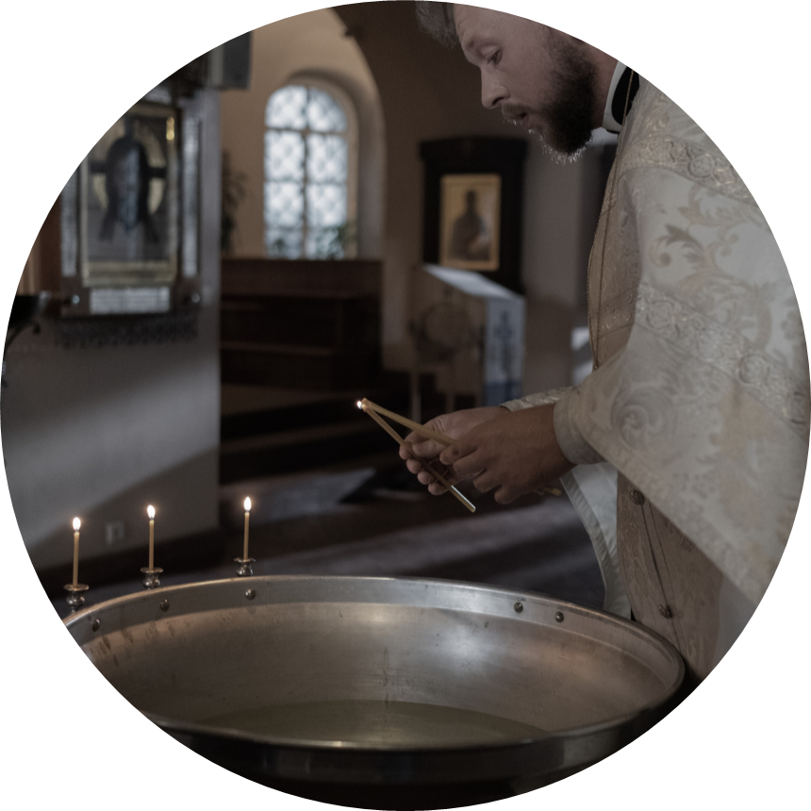
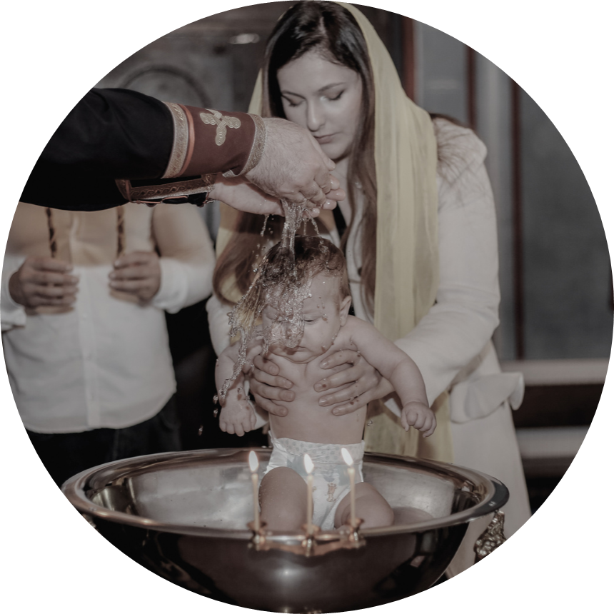
2 out of 5
95%
12 million
  Elaborate on the featured statistic.
  Elaborate on the featured statistic.
  Elaborate on the featured statistic.

Slide 17
Thank you!
We appreciate your participation and presence today. May your journey with faith and renewal continue to flourish.

Slide 18
Resource Page
  Use these design resources in your Canva Presentation.
Fonts
Design Elements
This presentation template
uses the following free fonts:
TITLES:
VIDALOKA
HEADERS:
VIDALOKA
BODY COPY:
NUNITO LIGHT
You can find these fonts online too.
Colors
#FFFFFF
#0F1A38

Slide 19

Credits
  This presentation template is free for everyone to use thanks to the following:
  for the presentation template
Pexels, Pixabay
  for the photos
Happy designing!

