Slide 1


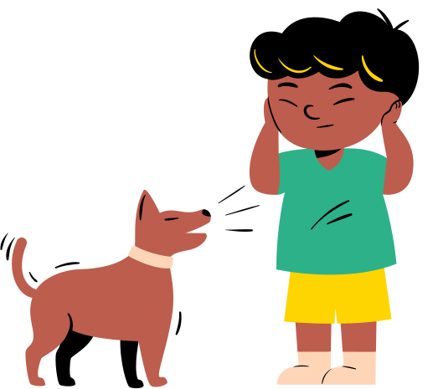







Biology Subject for kids
The Five Senses

Slide 2



How to Use This Presentation
Google Slides
PowerPoint
Canva
  Click on the "Google Slides" button below this presentation preview.
  Click on "Make a copy."
  Start editing your presentation.
  You need to sign in to your Google account.
  Click on the "PowerPoint" button below this presentation preview.
  Start editing your presentation.
  Download and install the fonts used in this presentation as listed on the next page.
  Click on the "Canva" button under this presentation preview.
  Start editing your presentation.
  You need to sign in to your Canva account.

Slide 3




Add an Agenda Page
Write an agenda here.
Write an agenda here.
Write an agenda here.
Write an agenda here.
Write an agenda here.

Slide 4






Exploring the Human Senses
Taste
Smell
Sight
Briefly elaborate on what you want to discuss.
Briefly elaborate on what you want to discuss.
Briefly elaborate on what you want to discuss.
Hearing
Touch
Briefly elaborate on what you want to discuss.
Briefly elaborate on what you want to discuss.

Slide 5





Hello there!
I'm Rain, and I'll be sharing with you my beautiful ideas.
Follow me at @reallygreatsite to learn more.

Slide 6
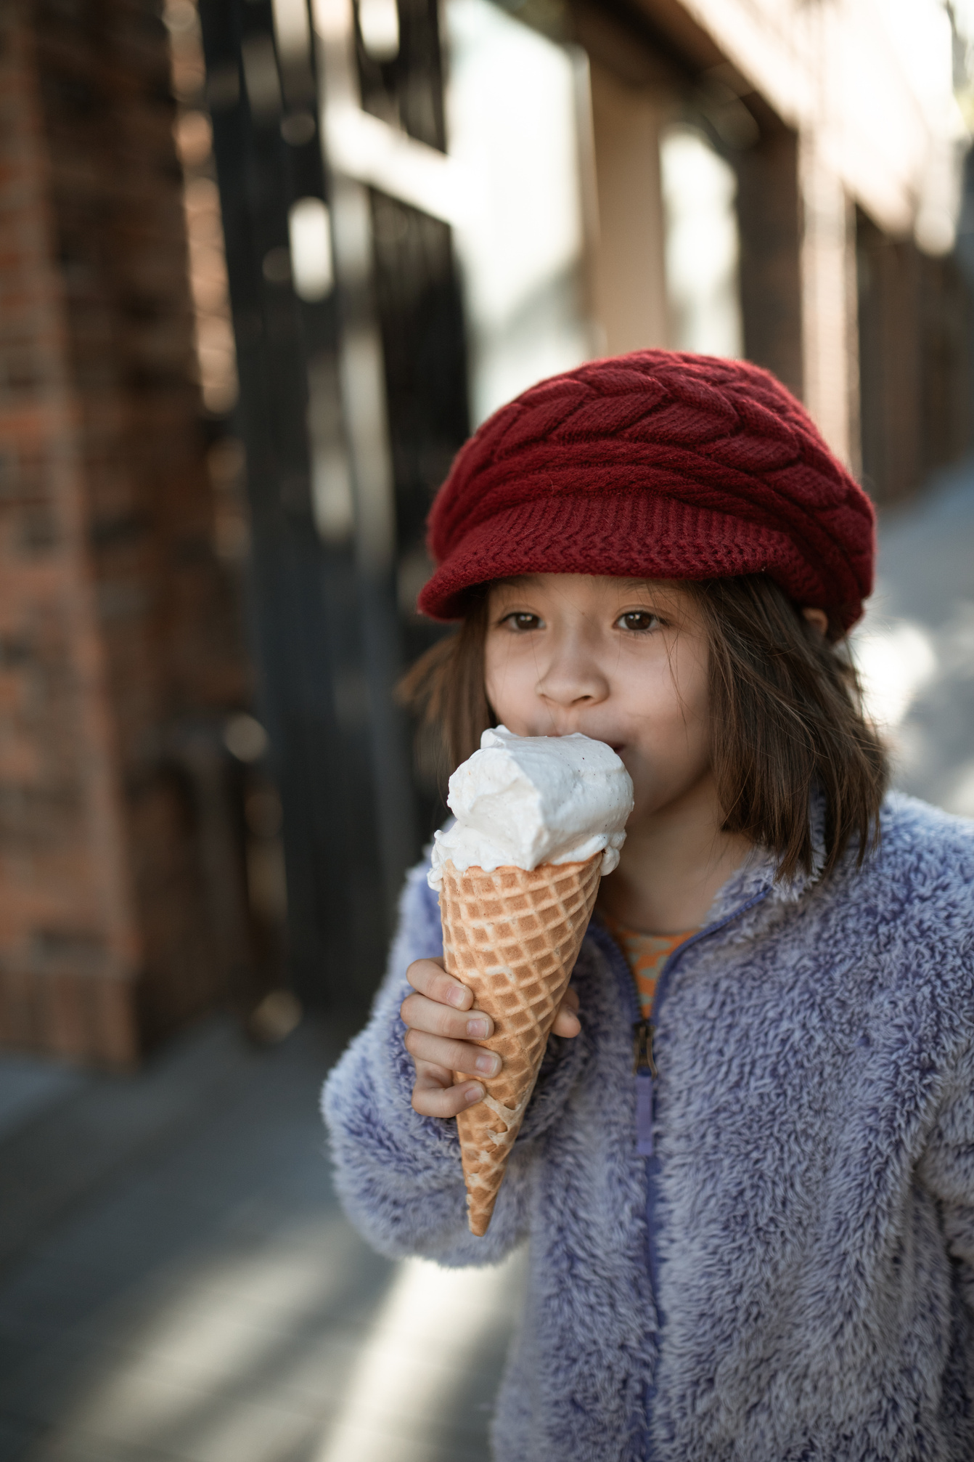




Sense of Taste
Elaborate on what you want
to discuss.

Slide 7




Sense of Sight
Topic One
Topic Two
Elaborate on what you want to discuss.
Elaborate on what you want to discuss.
Topic Three
Topic Four
Elaborate on what you want to discuss.
Elaborate on what you want to discuss.

Slide 8







Add a main point
Elaborate on what you
want to discuss.
Add a main point
Elaborate on what you
want to discuss.
Add a main point
Elaborate on what you
want to discuss.
Sense of Smell
Add a main point
Elaborate on what you
want to discuss.
Add a main point
Elaborate on what you
want to discuss.
Add a main point
Elaborate on what you
want to discuss.

Slide 9
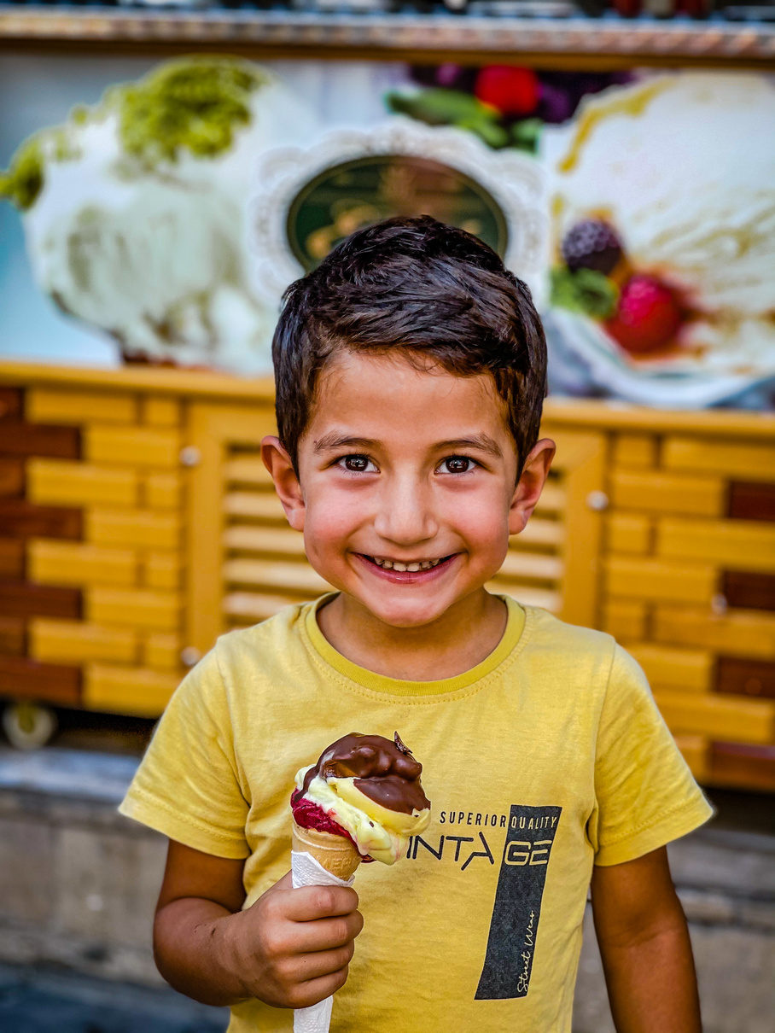








Write a caption for the photos.

Slide 10



The sense of touch is responsible for detecting pressure, temperature, and pain.
— Include a credit, citation, or supporting message

Slide 11





Add a Section Header

Slide 12



Write Your Big Topic or Idea
Elaborate on what you want to discuss.

Slide 13




10,000
The average human has 10,000 taste buds.
20,000 Hz.
The human ear can detect sounds as low as 20 Hz and as high as 20,000 Hz.

Slide 14




Important Data
Elaborate on the featured statistic
43%
60%
35%
Elaborate on the
featured statistic.
Elaborate on the
featured statistic.
Elaborate on the
featured statistic.

Slide 15



Thank you!
Write a closing statement or call-to-action here.

Slide 16



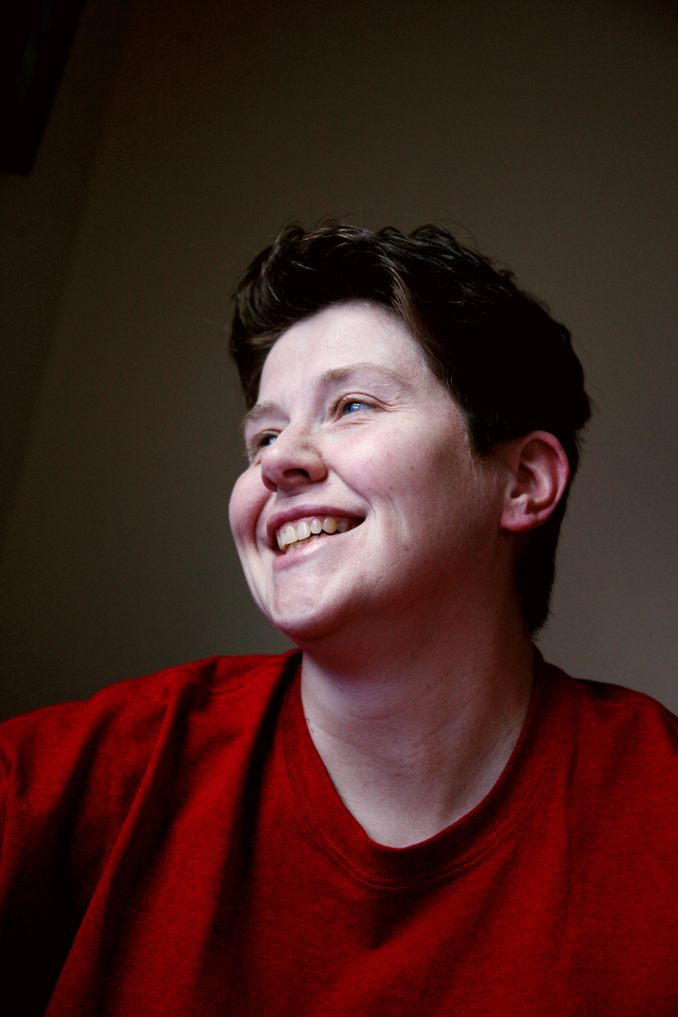



Add a Team Members Page
Elaborate on what you want to discuss.
Name
Name
Name
Name
Title or Position
Title or Position
Title or Position
Title or Position

Slide 17

Credits
This presentation template is free for everyone to use thanks to the following:
SlidesCarnival for the presentation template
Pexels for the photos
Happy designing!

Slide 18

Resource
Page
Use these design resources in your Canva Presentation.
You can find these fonts online too. Happy designing!
Don't forget to delete this page before presenting.
This presentation template uses the following free fonts:
Titles: Paytone One
Headers: Paytone ﻿One
Body Copy: Nunito Light

Slide 19








Resource
Page
Use these design resources in your Canva Presentation.
You can find these fonts online too. Happy designing!
Don't forget to delete this page before presenting.
This presentation template uses the following free fonts:
Titles: Paytone One
Headers: Paytone ﻿One
Body Copy: Nunito Light

Slide 20


Free templates for all your presentation needs
For PowerPoint, Google Slides,
and Canva
100% free for personal or commercial use
Ready to use, professional,
and customizable
Blow your audience away with
attractive visuals

