Slide 1
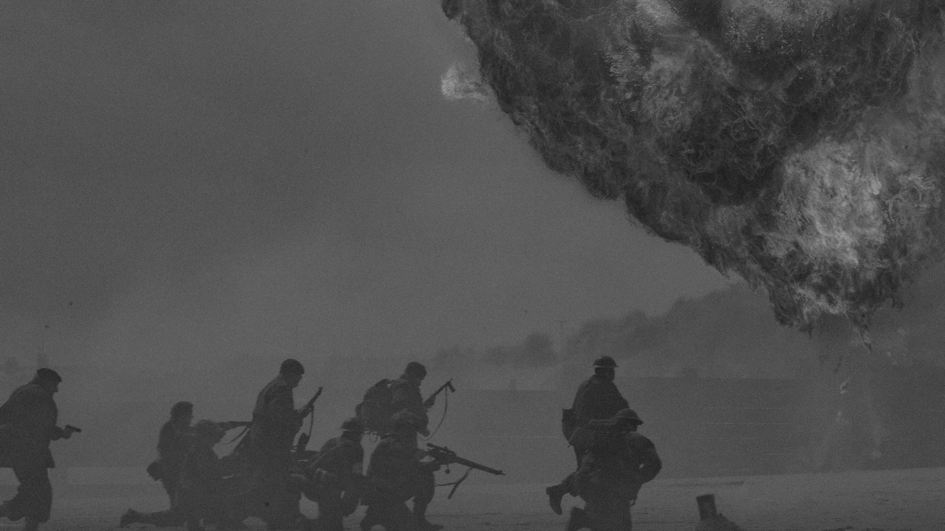
World War I
WW1
HISTORY CLASS
KEY FACTS OF WWI
BY SLIDECORE

Slide 2
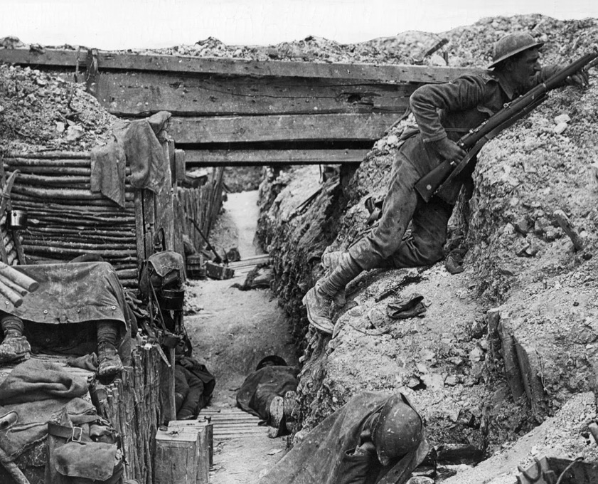
1914–18
The Great War
World War I (1914–18), also called the First World War or Great War, was the most deadly and destructive war the world had ever seen to that time.
  A British soldier inside a trench on the Western Front during World War I, 1914–18.
  Hulton Archive/Getty Images

Slide 3
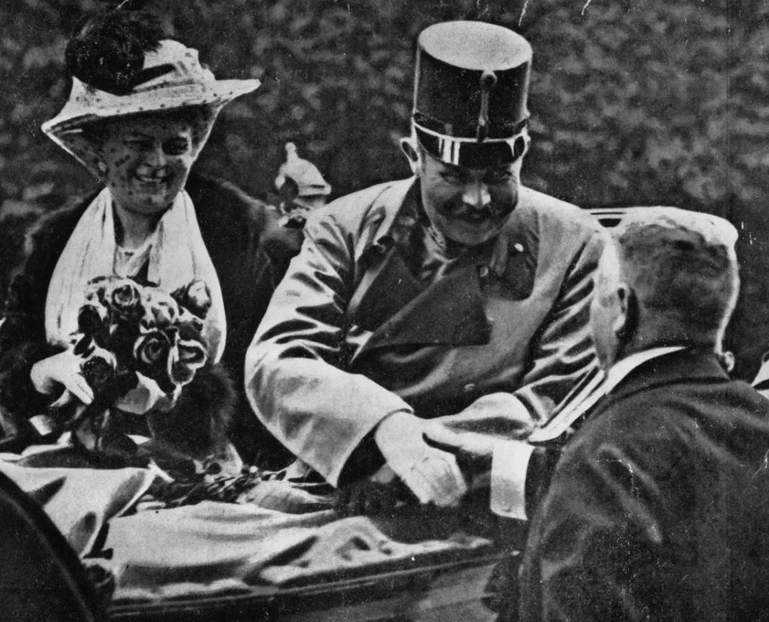
JUNE 28, 1914
Franz Ferdinand
On June 28, 1914, Austrian Archduke Franz Ferdinand and his wife were assassinated by a Bosnian Serb nationalist, leading Austria-Hungary to declare war on Serbia on July 28.
  Archduke Franz Ferdinand and his wife, Sophie
  Henry Guttmann Collection—Hulton Archive/Getty Images

Slide 4
Triple Alliance
For many years rival groups of European nations had been making treaties and alliances. By 1914 Europe had been divided into two camps. Germany, Austria-Hungary, and Italy were members of the Triple Alliance.
  The Triple Alliance
  Source: Wikipedia

Slide 5
Central Powers & Triple Entente
Later, after the withdrawal of Italy and the addition of Turkey, the Triple Alliance took a new name, the Central Powers. Russia, France, and Great Britain had formed the rival Triple Entente. Later they were called the Allies. Except for Bulgaria, the Balkan states sided with Serbia and the Allies.
  Central Powers
  Triple Entente

Slide 6

These alliances were brought into action by Austria-Hungary’s declaration of war.

Slide 7
Within a week most of Europe was at war.

Slide 8
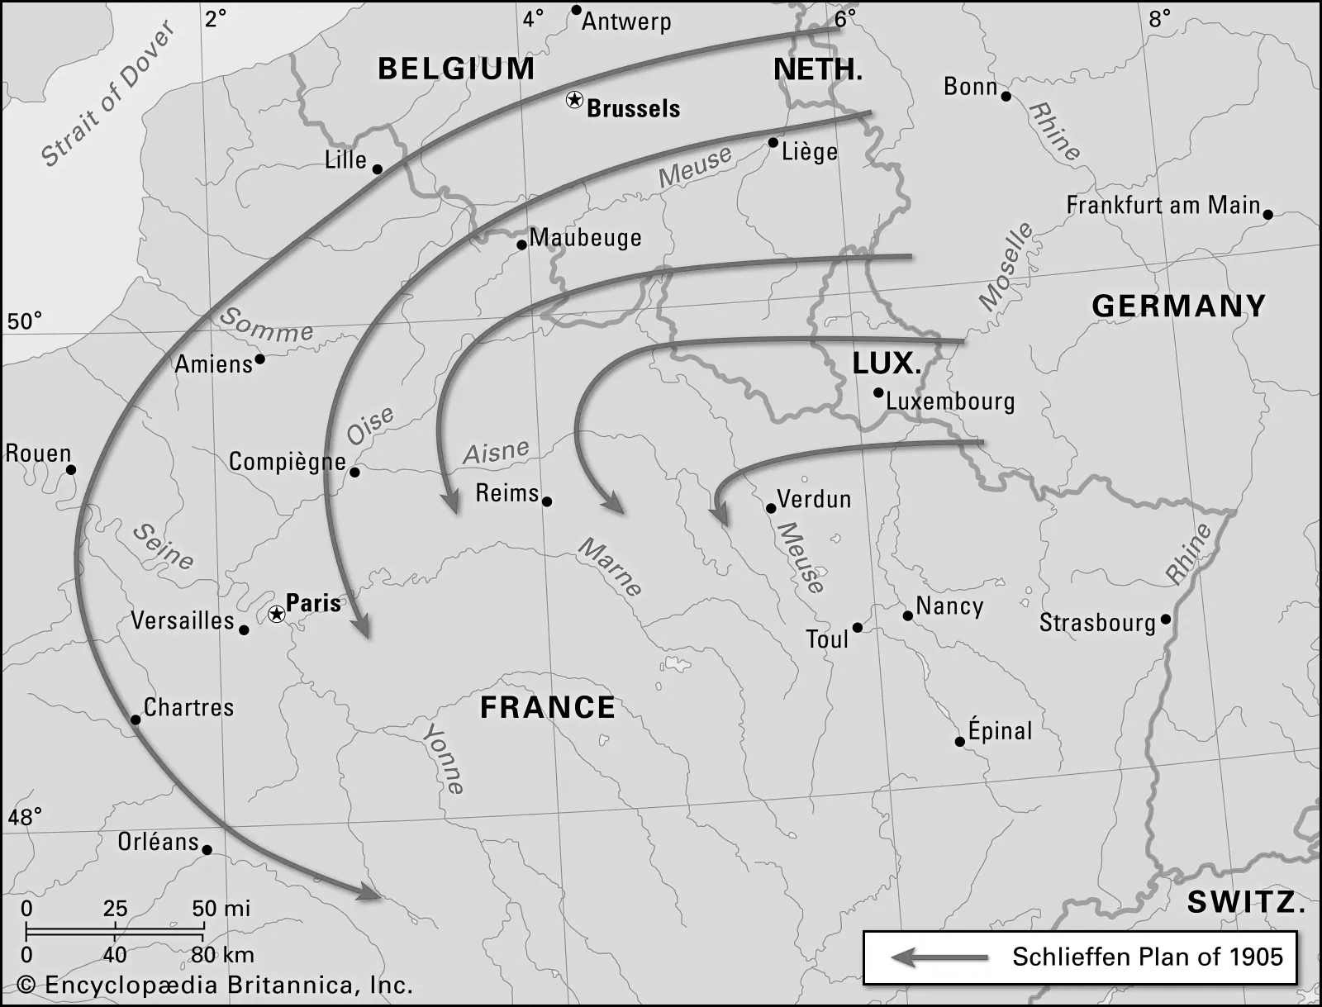
Schlieffen Plan
Using the Schlieffen Plan, Germany planned to conquer France first and then quickly move troops east to defeat Russia. The strategy failed when the British army joined France and blocked the Germans’ advance before they reached Paris.
  Schlieffen Plan
  Battle plan first proposed in 1905 by Alfred, Graf (count) von Schlieffen, chief of the German general staff, that was designed to allow Germany to wage a successful two-front war

Slide 9
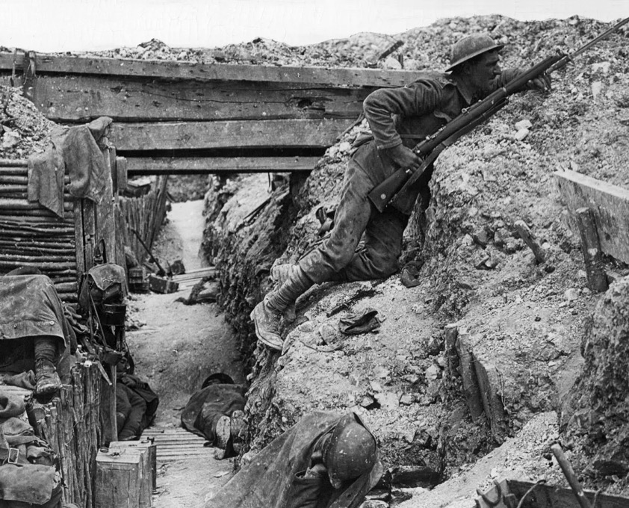

Trench warfare
Trench warfare reached its height during the war. Troops fighting for the Allies and Central Powers dug complex networks of trenches into the ground for use in making attacks or defending themselves.
  A British soldier inside a trench on the Western Front during World War I, 1914–18.
  Hulton Archive/Getty Images
Trench warfare is a type of combat in which the opposing sides attack, counterattack, and defend from relatively permanent systems of trenches dug into the ground.

Slide 10
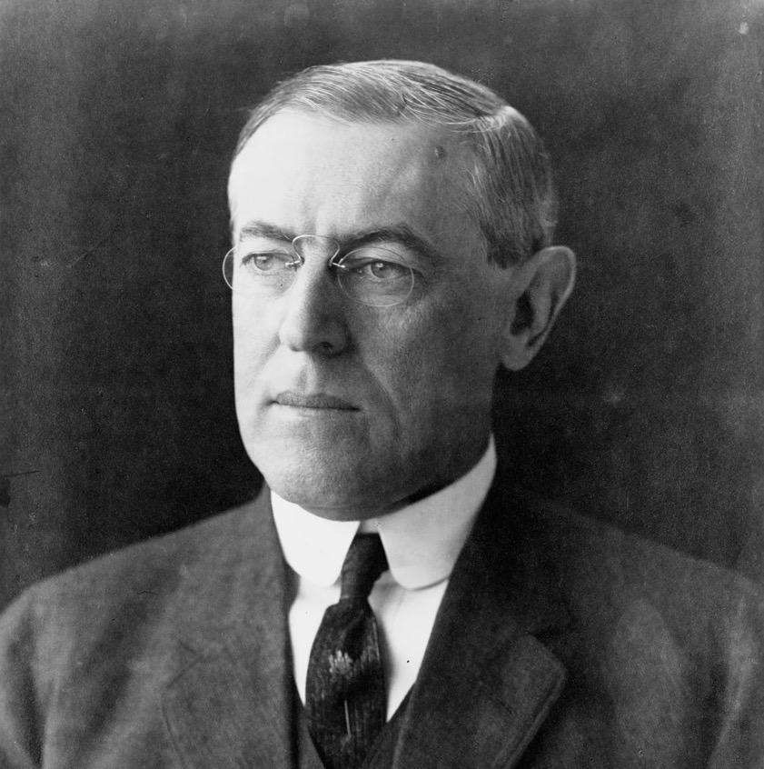
United States
The United States initially stayed out of the war. President Woodrow Wilson asserted a policy of neutrality.
Despite this policy, the United States (before eventually entering the war) supplied the Allies with weapons and goods.
  Woodrow Wilson.
  Library of Congress, Washington, D.C. (neg. no. LC-USZ62-13028)

Slide 11
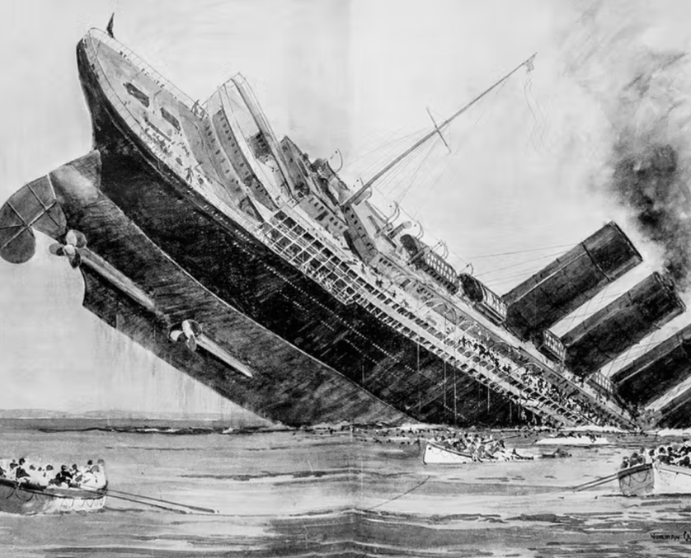
MAY 7, 1915
German submarine sank a British passenger liner
On May 7, 1915, a German submarine sank the British passenger liner Lusitania. The ship had been carrying some ammunition, and Germany felt justified in treating it as a legitimate target in a declared war zone.
President Wilson demanded an apology from Germany. The Germans agreed to stop attacking civilian ships but later resumed unlimited submarine attacks to cut off supplies coming into Great Britain.
  The tragedy at sea captured by a London Illustrated News artist Norman Wilkinson

Slide 12
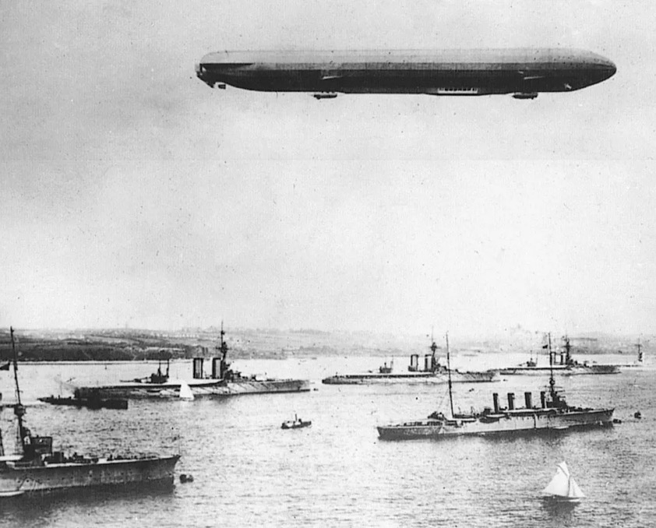
Improved
technologies
New and improved technologies, such as machine guns, air warfare, tanks, and radio communications, made fighting more deadlier than ever before and led to massive numbers of casualties.
Zeppelin
A cigar-shaped German zeppelin flies over warships anchored in the harbor at Kiel, Germany, during a World War I maneuver. They were named for their designer, Count Ferdinand von Zeppelin.
Source: Encyclopædia Britannica, Inc.

Slide 13
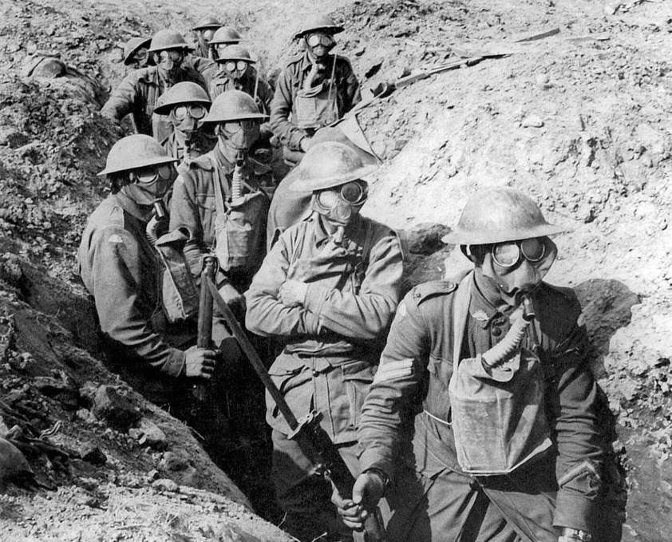
Second Battle of Ypres
The Germans introduced chemical weapons, using poison gas in the Second Battle of Ypres in western Belgium. By war’s end both sides had used massive quantities of chemical weapons, causing an estimated 1,300,000 casualties, including 91,000 fatalities.
Second Battle of Ypres, (April 22–May 25, 1915), second of three costly battles in World War I at Ypres (now Ieper), in western Flanders. The battle marked the Germans’ first use of poison gas as a weapon. Although the gas attack opened a wide hole in the Allied line, the Germans failed to exploit that advantage.
  Gas masks at the Second Battle of Ypres
  Australian soldiers wearing gas masks during the Second Battle of Ypres, 1915.
  Image: Asset Managemen/World History Archive/age fotostock

Slide 14
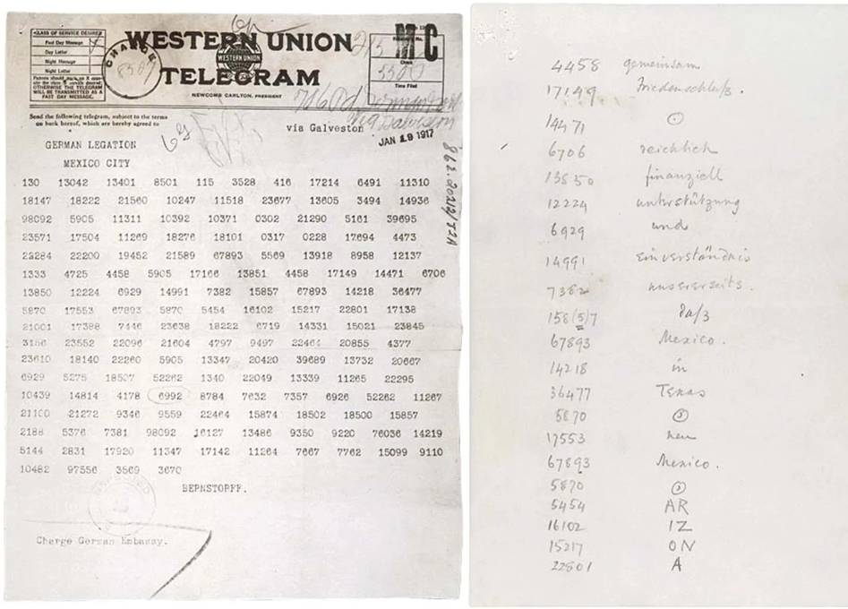
JAN 16, 1917
Arthur
Zimmermann
On January 16, 1917, German foreign minister Arthur Zimmermann secretly sent a telegram to the German minister in Mexico. It instructed the German minister to propose a Mexican-German alliance should the United States enter the war.
Zimmermann Note
Encoded text of the “Zimmermann Note,” sent January 16, 1917, in which Germany proposed a military alliance with Mexico against the United States.
National Archives, Washington, D.C.

Slide 15

APRIL 6, 1917
United States enters
the war
After Germany resumed unrestricted submarine warfare and following the discovery of the Zimmermann Telegram, the United States entered the war on April 6.

Slide 16
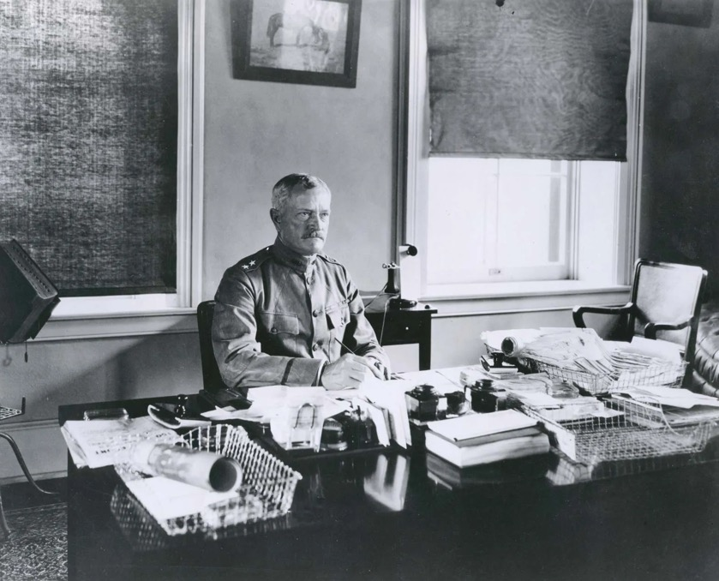
AEF
The United States established the American Expeditionary Forces (AEF), headed by General John J. Pershing, to fight in Europe.
John J. Pershing, 1917.
Image: Library of Congress, Washington, D.C.

Slide 17
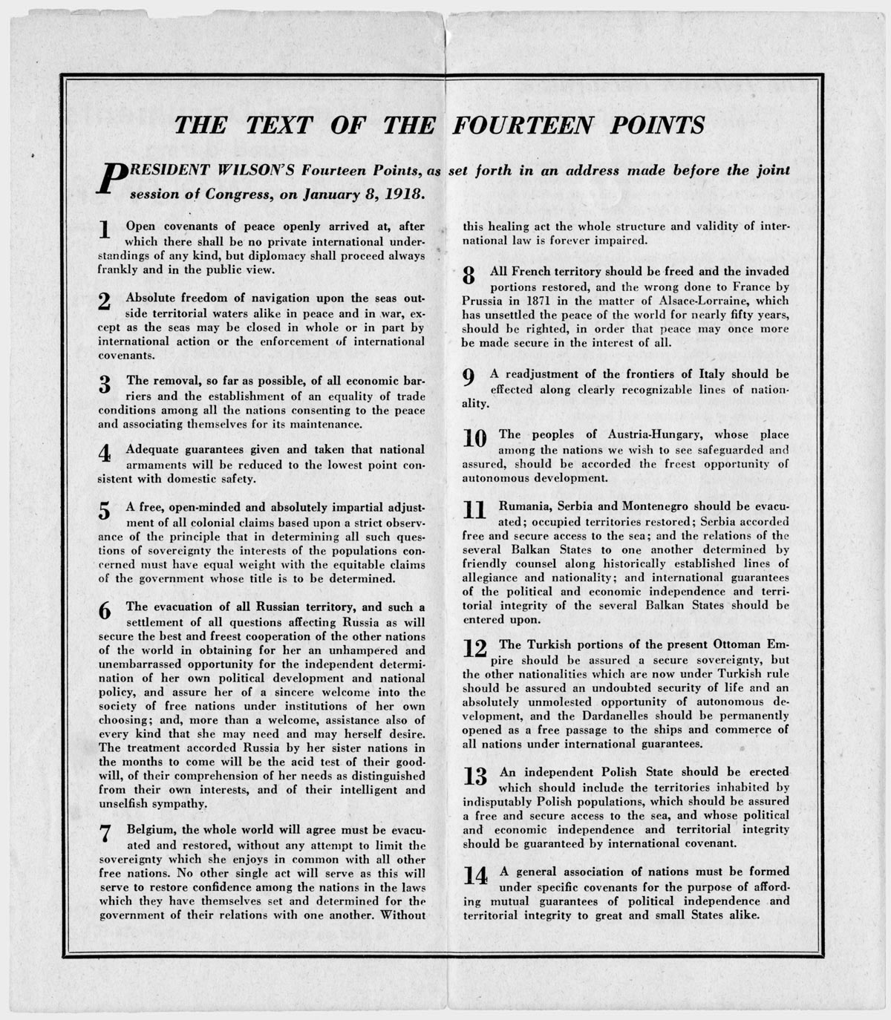
JANUARY 8,1918
Fourteen Points for peace
On January 8, 1918, President Wilson presented to Congress his outline of Fourteen Points for peace.
The Points, Summarized
1. Open diplomacy without secret treaties
2. Economic free trade on the seas during war and peace
3. Equal trade conditions
4. Decrease armaments among all nations
5. Adjust colonial claims
6. Evacuation of all Central Powers from Russia and allow it to define its own independence
7. Belgium to be evacuated and restored
8. Return of Alsace-Lorraine region and all French territories
9. Readjust Italian borders
10. Austria-Hungary to be provided an opportunity for self-determination
11. Redraw the borders of the Balkan region creating Roumania, Serbia and Montenegro
12. Creation of a Turkish state with guaranteed free trade in the Dardanelles
13. Creation of an independent Polish state
14. Creation of the League of Nations
  The Fourteen Points were a proposal made by U.S. President Woodrow Wilson in a speech before Congress on January 8, 1918, outlining his vision for ending World War I in a way that would prevent such a conflagration from occurring again.

Slide 18
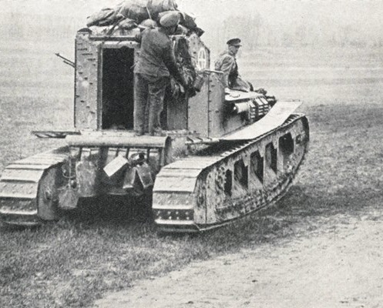
Second Battle of the Somme
On March 21 the Germans launched the Second Battle of the Somme in France and advanced more than 40 miles (64 kilometers) westward. The Germans continued their offensive push over the next couple of months but were stopped by American counterattacks.
Whippets going off to battle tank.
Image: www.forces-war-records.co.uk
Second Battle of the Somme
Second Battle of the Somme, also called Battle of Saint-Quentin, (March 21–April 5, 1918), partially successful German offensive against Allied forces on the Western Front during the later part of World War I.

Slide 19
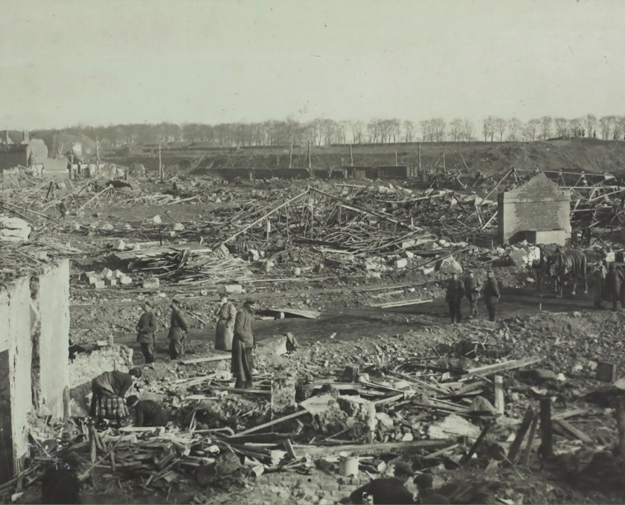
Armistice
Bulgaria signed an armistice on September 29. The Ottoman Empire surrendered on October 30. Austria-Hungary was granted armistice on November 3.

Slide 20
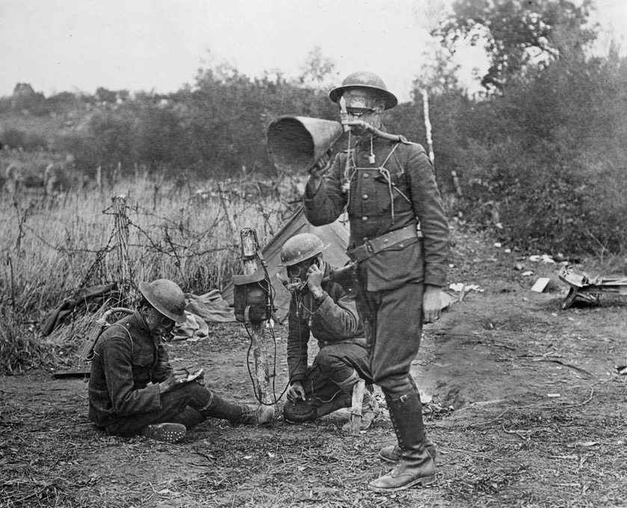
The final
offensive
Allied forces began attacks at Meuse-Argonne, the final offensive of the war. The battles of the Meuse-Argonne continued from September 26 until November 11. The Allies repeatedly attacked the German defensive line, forcing the Germans to retreat.
World War I; chemical weapon
U.S. soldiers using gas equipment and receiving telephone instructions during the Meuse-Argonne offensive, Varennes-en-Argonne, France, 1918.
Source: National Archives, Washington, D.C.

Slide 21

Negotiations
for peace
The November 11 Armistice between Germany and the Allies ended the fighting, and negotiations for peace began.

Slide 22
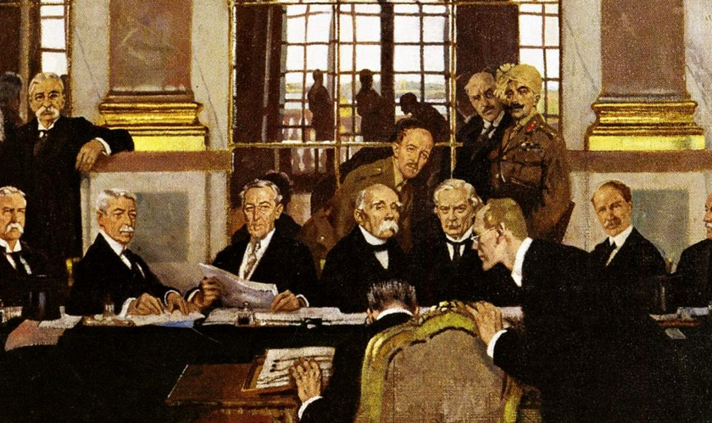
JAN, 1919
The Paris Peace
Conference
The Paris Peace Conference began in January 1919 in Paris. The conference inaugurated the international settlement after World War I.
Paris Peace Conference
Johannes Bell of Germany is portrayed as signing the peace treaties on 28 June 1919 in The Signing of Peace in the Hall of Mirrors
Source: William Orpen - Imperial War Museum London

Slide 23
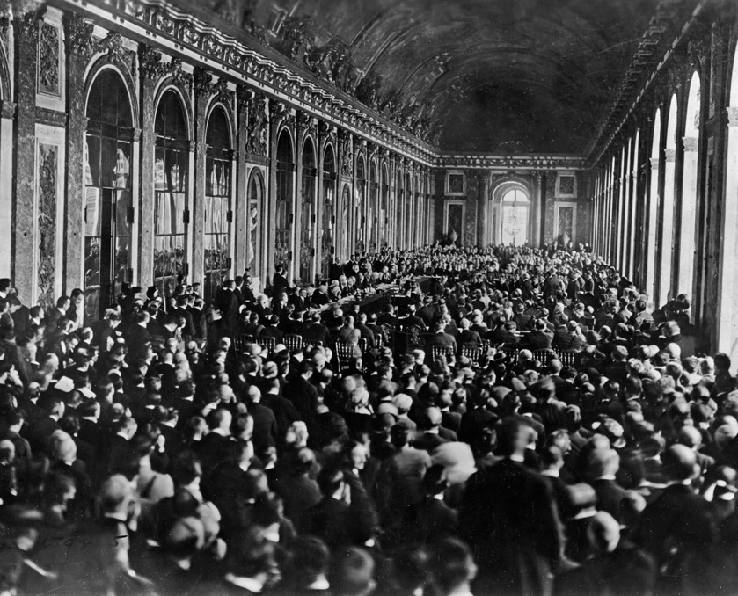
Treaty of Versailles
A major product of the Paris Peace Conference was the Treaty of Versailles, signed in June 1919 at the Palace of Versailles in France. Under the agreement, Germany was forced to accept blame for Allied losses and to pay major reparations. Also formulated at the Paris Peace Conference was the League of Nations, an organization for international cooperation established by the Allies.
  Treaty of Versailles
  Dignitaries gathering in the Hall of Mirrors at the Palace of Versailles, France, for the signing of the Treaty of Versailles, June 28, 1919.
  Image: Encyclopædia Britannica, Inc.

Slide 24
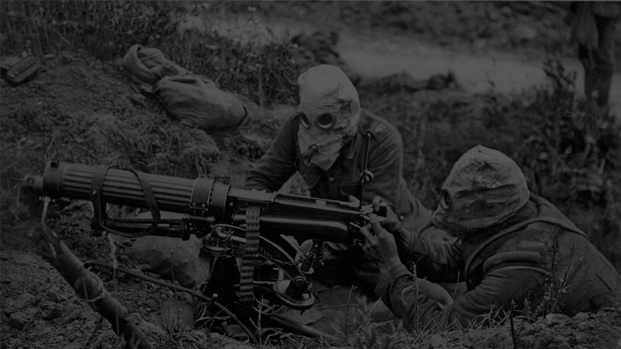
WW1
World War I Timeline
They key facts of WW1 in timeline mode

Slide 25
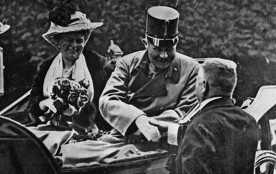

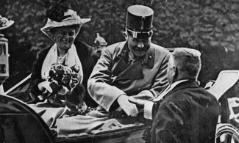
World War I Timeline
➔
June 28, 1914
July 28, 1914
Archduke Franz Ferdinand of Austria and his wife, Sophie, are assassinated on a visit to Sarajevo by a Bosnian Serb nationalist.
World War I begins when Austria-Hungary declares war on Serbia. A chain of threats and mobilizations soon results in a general war between the Central and Allied powers.

Slide 26
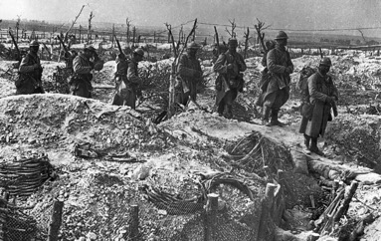
➔
September 6, 1914
November 5, 1914
The First Battle of the Marne begins. The Germans advance to within 30 miles (48 kilometers) of Paris but are stopped by the British and the French. Trench warfare begins.
Britain and France declare war on the Ottoman Empire.

Slide 27
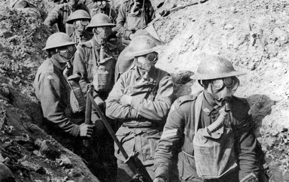
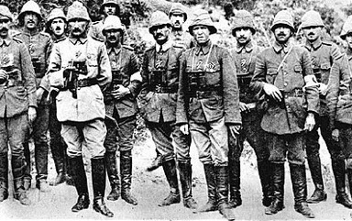
➔
April 22, 1915
April 25, 1915
The Second Battle of Ypres begins. The German army initiates the modern era of chemical warfare by using chlorine gas as a weapon on Allied trenches. Some 5,000 French and Algerian troops are killed.
Allied forces land on the Gallipoli Peninsula of the Ottoman Empire, beginning the nine-month-long Gallipoli Campaign. The campaign is a disaster almost from the beginning. Altogether, the Allies suffer more than 200,000 casualties and fail to capture the Ottoman capital of Constantinople (now Istanbul).

Slide 28
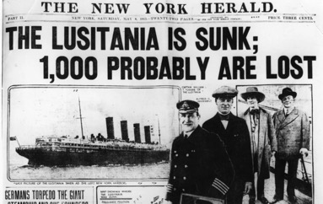
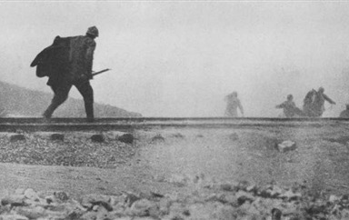
➔
May 7, 1915
February 21, 1916
A German U-boat sinks the British ocean liner Lusitania off the southern coast of Ireland during the ocean liner’s crossing from New York to England. Nearly 1,200 people are killed, including 128 U.S. citizens.
The Battle of Verdun begins. Over the next 10 months, French and German armies at Verdun, France, suffer more than 700,000 casualties, including some 300,000 killed.

Slide 29
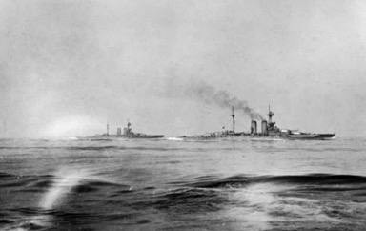
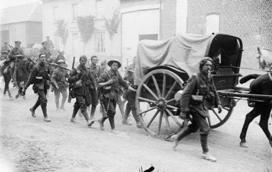
➔
May 31, 1916
July 1, 1916
The British and German fleets meet 60 miles (97 kilometers) off the coast of Jutland, Denmark, marking the start of the Battle of Jutland. It is the war’s only major battle between the world’s two largest sea powers. The clash of the battleships is largely indecisive.
The first day of the First Battle of the Somme marks the single bloodiest day in the history of the British army, with nearly 20,000 British soldiers killed in action. By the time the Somme campaign ends, some four and a half months later, the combined casualties of both sides surpass 1,000,000.

Slide 30
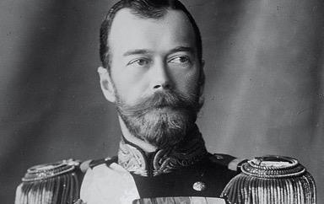

➔
March 15, 1917
April 6, 1917
Tsar Nicholas II of Russia abdicates the throne after a week of riots in the Russian capital of St. Petersburg. The Russian Revolution will ultimately place the Bolsheviks in power.
The United States declares war on Germany.
By June, American forces arrive in France.

Slide 31
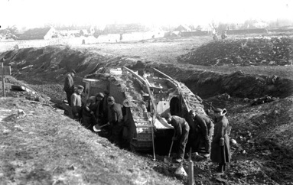
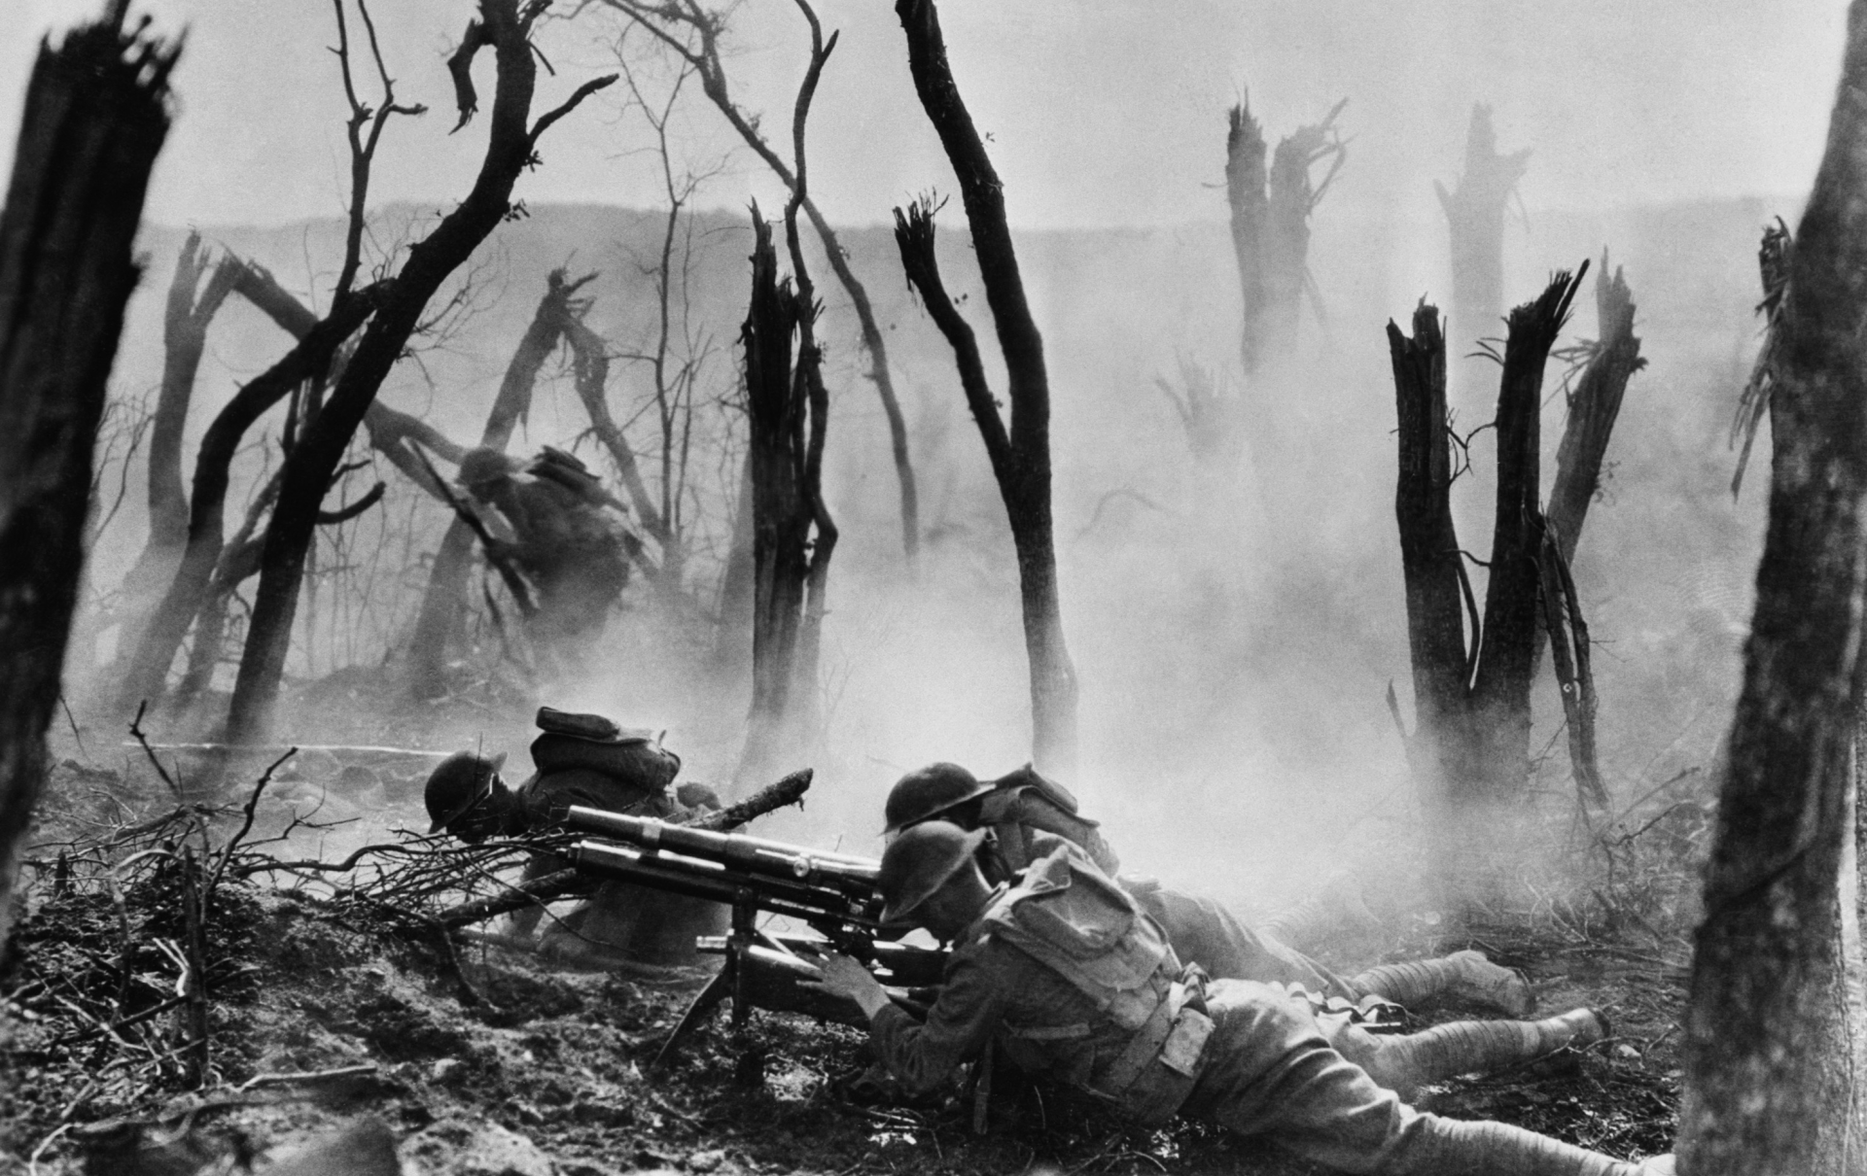
➔
November 20, 1917
September 26–November 11, 1918
A British offensive at Cambrai, France, marks the first large-scale use of tanks in combat. British advances are short-lived, however. British forces are driven back almost to their original positions two weeks later.
The battles of the Meuse-Argonne take place. The battles are the final confrontations on the Western Front in northeastern France in World War I. The Argonne Forest is cleared of German troops by the end of October, and the Allies soon advance to the town of Sedan, France. The Armistice is declared on November 11, before a final offensive against Germany itself can begin.

Slide 32
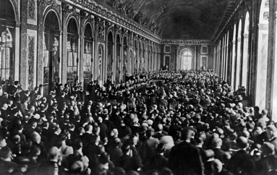
June 28, 1919
The Allied and associated powers and Germany sign the Treaty of Versailles peace agreement.

Slide 33
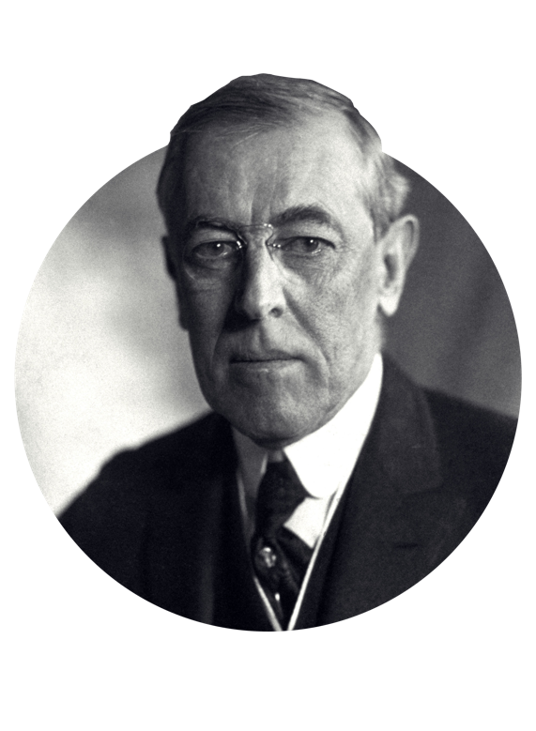
“
This is a war to
end all wars
”
WOODROW WILSON, 1917

Slide 34
WW1
Transition slide
A beautiful and artsy template to inspire yourself and others
NEXT CHAPTER

Slide 35
Chronology editbale template (excel)
Suspendisse quis facilisis tempus massa. In eleifend volutpat porttito scelerisque, ipsum ac pretium pretium.
1918
1914
Important event
Important event
Data name one
Data name two

Slide 36
Social editbale template (excel)
POPULATION
ARMY
DIPLOMACY
43%
24%
76%
Social group 1
Social group 1
Social group 1
Social group 2
Social group 2
Social group 2

Slide 37
WW1
Clean Slide
Suspendisse quis facilisis tempus massa.
In eleifend volutpat porttito scelerisque.

Slide 38
  Editable Icon Set
Things you can do:
Resize the icon
Change fill color and opacity
Add stroke
Add dash lines

Slide 39

This template was made specially for you by
Big shout-out to the great people that provided us with the free resources of this presentation:
STOCK IMAGES
unsplash.com
pixabay.com
ICONS
Thick Icons
Nice and Serious
Visit slidecoretemplates.com to get more editable premium presentations for free
SOURCE
Brittanica.com
https://www.britannica.com/summary/Key-Facts-of-World-War-I

