Slide 1

INFOGRAPHIC DESIGN
PROJECT MANAGEMENT

Slide 2

HELLO & WELCOME
TO PRESENTATION
WELCOME MESSAGE
Presentations are communication tools that can be used as demonstrations, lectures, speeches, reports, and more. It is mostly presented before an audience.
LETS GET STARTED

Slide 3

ADD AN AGENDA PAGE
WRITE AN AGENDA HERE.
WRITE AN AGENDA HERE.
WRITE AN AGENDA HERE.
WRITE AN AGENDA HERE.
WRITE AN AGENDA HERE.

Slide 4



HOW TO USE THIS PRESENTATION
CANVA
POWERPOINT
GOOGLE SLIDES
Click on the "Canva" button under this presentation preview. Start editing your presentation. You need to sign in to your Canva account.
Export this design from Canva as a PowerPoint template. Open the design in Canva. This will provide you with all the fonts used and elements used in this presentation as listed on page 21. Learn more on slide 4.
Export this design from Canva as a GoogleSlide template. This will provide you with all the fonts used and elements used in this presentation as listed on page 21. Learn more on slide 5.

Slide 5



DOWNLOAD THIS PRESENTATION AS A POWERPOINT TEMPLATE IN 3 STEPS
1.
2.
3.
Click on the "Canva" button next to this presentation. Start editing your presentation. You may need to sign in to your Canva account.
Click on the "Share" button on the top right corner in Canva and click on "More" at the bottom of the menu.
Enter "PowerPoint" in the search bar and click on the PowerPoint icon to download.

Slide 6

DOWNLOAD THIS PRESENTATION AS A GOOGLE SLIDE TEMPLATE IN 3 STEPS
1.
2.
3.
Click on the "Canva" button next to this presentation. Start editing your presentation. You may need to sign in to your Canva account.
Click on the "Share" button on the top right corner in Canva and click on "More" at the bottom of the menu.
Enter "Google Drive" in the search bar and click on the Google Drive icon to add this design as a Google slide in your G Drive. It will ask you to link your Google account to Canva the first time.

Slide 7





STEP ONE
STEP TREE
Presentations are
communication tools
Presentations are
communication tools
STEP TWO
STEP FOUR
Presentations are
communication tools
Presentations are
communication tools

Slide 8

INFOGRAPHIC REPORT
EXAMPLE | EXAMPLE | EXAMPLE | EXAMPLE | EXAMPLE | EXAMPLE
EXAMPLE | HIGH | LOW | LOW | MODERATE | HIGH
EXAMPLE | MODERATE | MODERATE | MODERATE | MODERATE | HIGH
EXAMPLE | HIGH | MODERATE | HIGH | LOW | HIGH
EXAMPLE | LOW | HIGH | MODERATE | MODERATE | LOW
EXAMPLE | MODERATE | LOW | HIGH | MODERATE | LOW
EXAMPLE | MODERATE | MODERATE | LOW | HIGH | MODERATE

Slide 9
INFOGRAPHIC REPORT
ELABORATE ON THE DATA YOU WANT TO DISCUSS
Elaborate on the step here
Elaborate on the step here
STEP 1
STEP 2
STEP 3
STEP 4
STEP 5
Elaborate on the step here
Elaborate on the step here
Elaborate on the step here

Slide 10
ADD AN INFOGRAPHIC PAGE
50
40
Elaborate on the data you want to discuss.
30
20
10
0
ITEM 1
ITEM 2
ITEM 3
ITEM 4
ITEM 5

Slide 11




STEP ONE
Presentations are communication tools that can be used as demonstrations.
EXAMPLE
ONE
STEP ONE
Presentations are communication tools that can be used as demonstrations.
STEP ONE
Presentations are communication tools that can be used as demonstrations.

Slide 12
ADD A TIMELINE PAGE
ADD A
MAIN POINT
ADD A
MAIN POINT
ADD A
MAIN POINT
ADD A
MAIN POINT
Elaborate on what you want to discuss.
Elaborate on what you want to discuss.
Elaborate on what you want to discuss.
Elaborate on what you want to discuss.

Slide 13
CHART SLIDE
REPORT
SERIES 1
SERIES 2
SERIES 3
PRODUCTION
Presentations are communication tools that can be used as demonstrations.
PRODUCTION
Presentations are communication tools that can be used as demonstrations.
PRODUCTION
Presentations are communication tools that can be used as demonstrations.

Slide 14
INFOGRAPHIC REPORT
STEP ONE
Presentations are communication tools that can be used as demonstrations.
STEP TWO
Presentations are communication tools that can be used as demonstrations.
STEP THREE
Presentations are communication tools that can be used as demonstrations.
STEP FOUR
Presentations are communication tools that can be used as demonstrations.
STEP ONE
Presentations are communication tools that can be used as demonstrations.

Slide 15





STEP ONE
STEP TWO
Presentations are communication tools that can be used as demonstrations.
Presentations are communication tools that can be used as demonstrations.
STEP THREE
STEP FOUR
Presentations are communication tools that can be used as demonstrations.
Presentations are communication tools that can be used as demonstrations.

Slide 16
INFOGRAPHIC REPORT
Presentations are communication tools that can be used as demonstrations, lectures, speeches, reports, and more. It is mostly presented before an audience.
SERIES 1
SERIES 2
SERIES 3
SERIES 1
SERIES 2
SERIES 3
SERIES 1
SERIES 2
SERIES 3

Slide 17
ADD AN INFOGRAPHIC PAGE
ITEM 5
20%
ITEM 1
20%
Elaborate on the data you want to discuss.
ITEM 4
20%
ITEM 2
20%
ITEM 3
20%

Slide 18




INFOGRAPHIC REPORT
EXAMPLE
EXAMPLE
EXAMPLE
EXAMPLE
Presentations are communication tools that can be used as demonstrations, lectures, speeches, reports, and more. It is mostly presented before an audience.
Presentations are communication tools that can be used as demonstrations, lectures, speeches, reports, and more. It is mostly presented before an audience.
Presentations are communication tools that can be used as demonstrations, lectures, speeches, reports, and more. It is mostly presented before an audience.
Presentations are communication tools that can be used as demonstrations, lectures, speeches, reports, and more. It is mostly presented before an audience.

Slide 19

S | W | O | T
STRENGTHS | WEAKNESSES | OPPORTUNITIES | THREATS
What are you doing well? What sets you apart? What are your good qualities? | Where do you need to improve? Are resources adequate? What do others do better than you? | What are your goals? Are demands shifting? How can it be improved? | What are the blockers you're facing? What are factors outside of your control?

Slide 20

2 OUT OF 5
Elaborate on the featured statistic.
95%
Elaborate on the featured statistic.
12 MILLION
Elaborate on the featured statistic.

Slide 21




ADD A TEAM MEMBERS PAGE
Elaborate on what you want to discuss.
NAME
NAME
NAME
NAME
Title or Position
Title or Position
Title or Position
Title or Position

Slide 22







ADD A CHART PAGE
Name
Job Title
Name
Job Title
Name
Job Title
Name
Job Title
Name
Job Title
Name
Job Title
Name
Job Title

Slide 23

CREDITS
This presentation template
is for everyone to use thanks
to the following:
SlidesCarnival for the presentation template
Pexels for the photos
HAPPY DESIGNING!

Slide 24
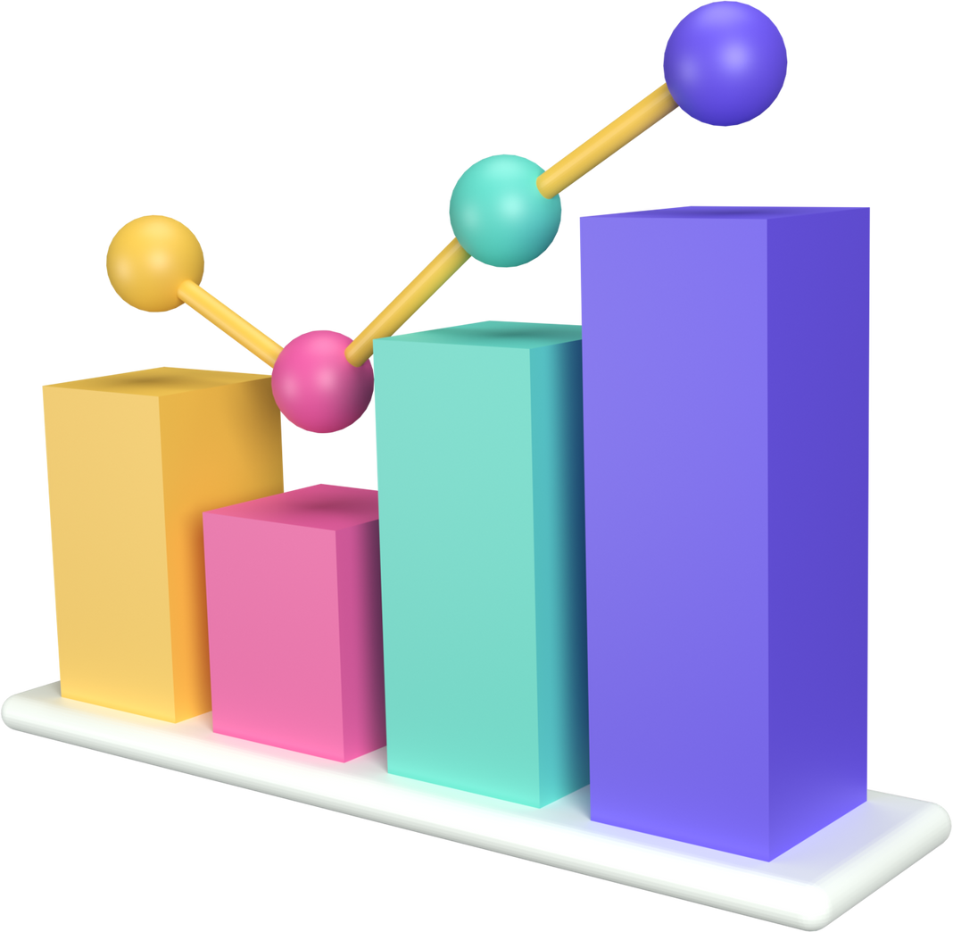
FONTS IN THIS
PRESENTATION
THIS PRESENTATION TEMPLATE USES THE FOLLOWING FONTS:
Titles: Bebas Neue Bold
Headers: Bebas Neue
Body Copy: Rubik
You can find these fonts online too.
Happy designing!

Slide 25








































ICONS
RESOURCE
PAGE
Use these design resources in your Canva Presentation. Happy designing!
Don't forget to delete this page before presenting.

Slide 26

THANKS FOR
WATCHING
Presentations are communication tools that can be used as demonstrations, lectures, speeches, reports, and more. It is mostly presented before an audience.

