Slide 1
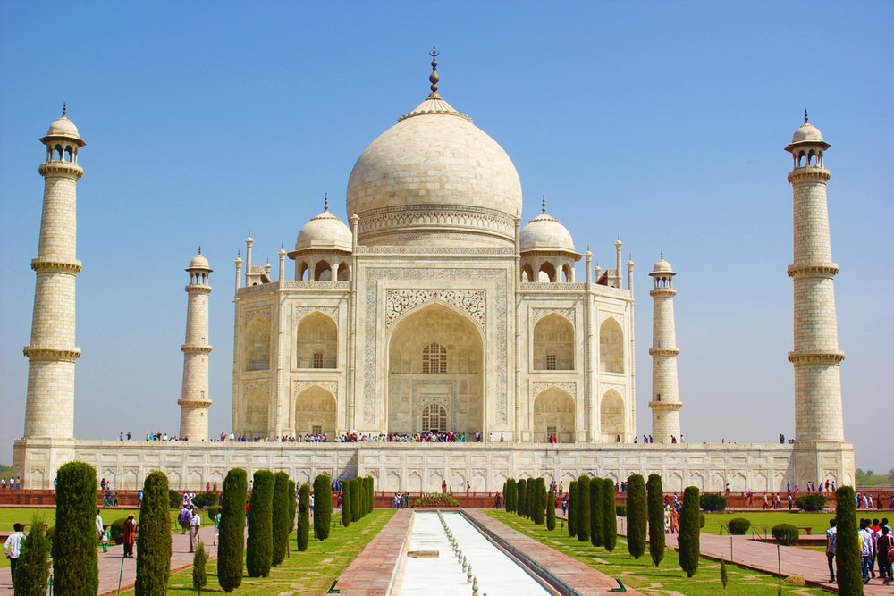
TRAVELING TO
INDIA

Slide 2
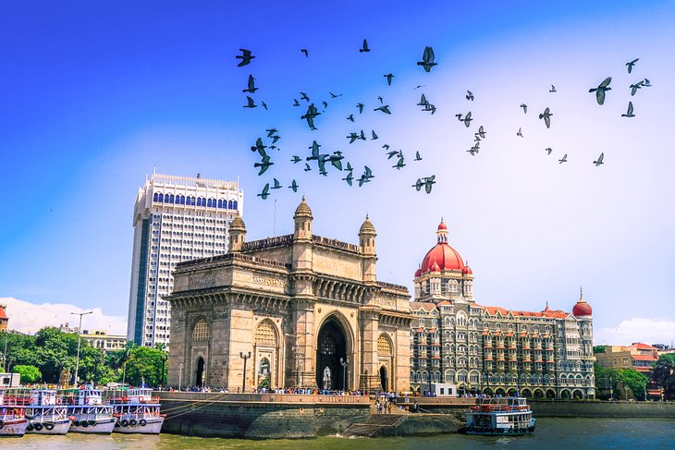
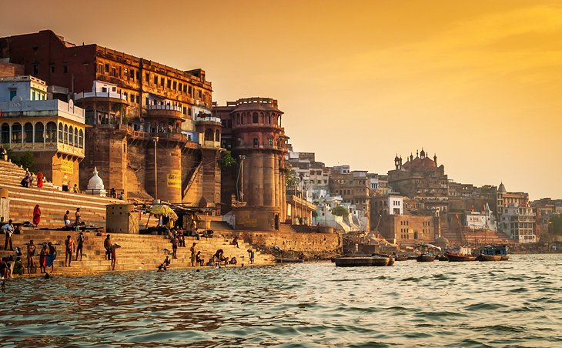
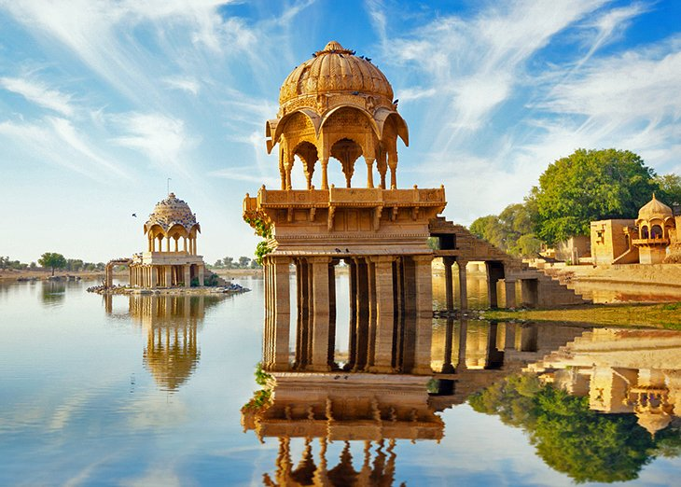
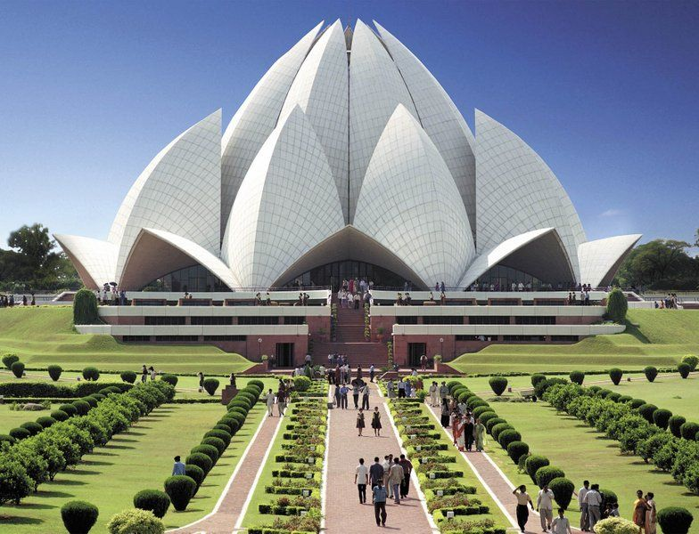
MAIN TITLE HERE
You can add you brief introduction of topic here
“
“
You can add you brief introduction of topic here You can add you brief introduction of topic here
You can add you brief introduction of topic here You can add you brief introduction of topic here You can add you brief introduction of topic here You can add you brief introduction of topic here
“
“

Slide 3
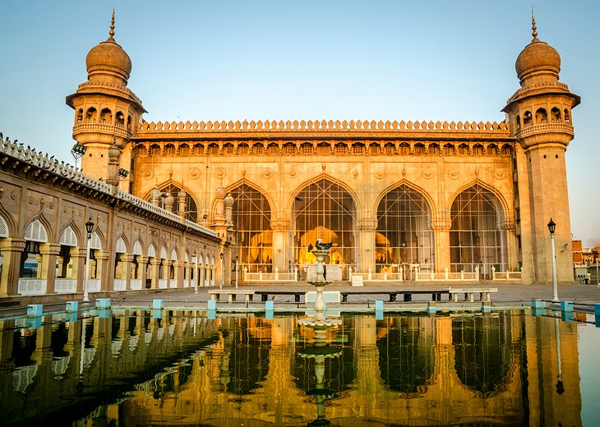
3
PASSIONATE
ABOUT VISITING INDIA
India is a wonderful place of the most extreme contrasts and a bit of culture shock is inevitable when you first arrive. Your driver can answer any questions you may have along the way, and help to ensure you travel safely and with respect to local customs. Your driver can answer any questions you may have along the way,

Slide 4
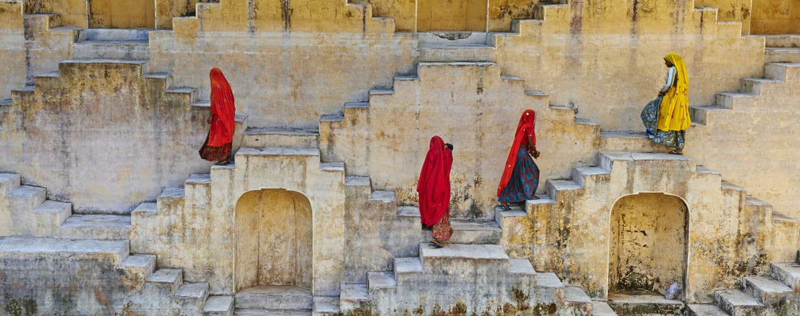
INDIAN CULTURAL DIVERSITY
4
1
2
3
Taj was built by Shah Jahan as a memorial for his third wife, Mumtaz Mahal, who died giving birth to their 14th child in 1631. The death of Mumtaz left the emperor so heartbroken that his hair is said to have turned grey virtually overnight. Following his death in 1666,
Taj was built by Shah Jahan as a memorial for his third wife, Mumtaz Mahal, who died giving birth to their 14th child in 1631. The death of Mumtaz left the emperor so heartbroken that his hair is said to have turned grey virtually overnight. Following his death in 1666,
Taj was built by Shah Jahan as a memorial for his third wife, Mumtaz Mahal, who died giving birth to their 14th child in 1631. The death of Mumtaz left the emperor so heartbroken that his hair is said to have turned grey virtually overnight. Following his death in 1666,

Slide 5
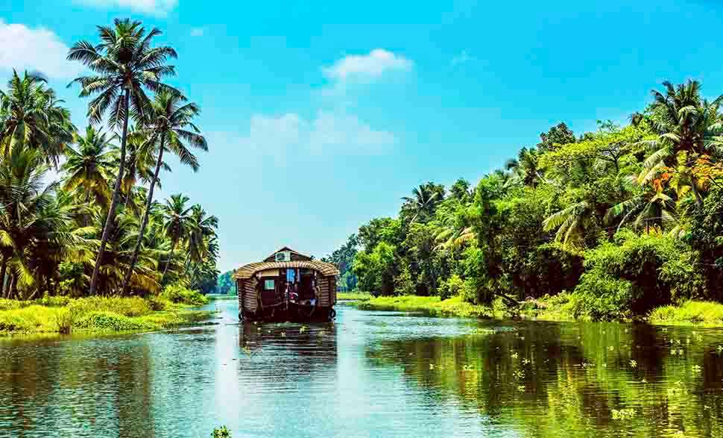
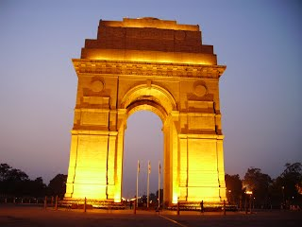
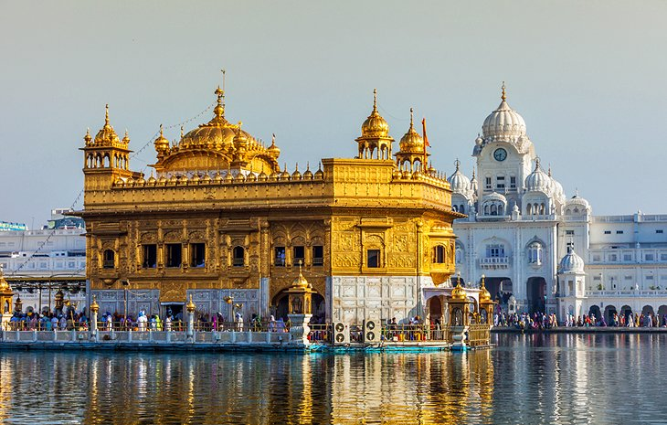
5
WELCOME TO INDIA
With its sumptuous mix of traditions, spiritual beliefs, festivals, architecture and landscapes, your memories of India will blaze bright long after you've left its shores.
  Heading
  it is expected to become the eighth-largest grocer on the continent by 2022. Over the past years X5 has been overtaking retail heavy-weights such as French Système U, British Morrisons and Swedish ICA Gruppen.
  Heading
  it is expected to become the eighth-largest grocer on the continent by 2022. Over the past years X5 has been overtaking retail heavy-weights such as French Système U, British Morrisons and Swedish ICA Gruppen.

Slide 6
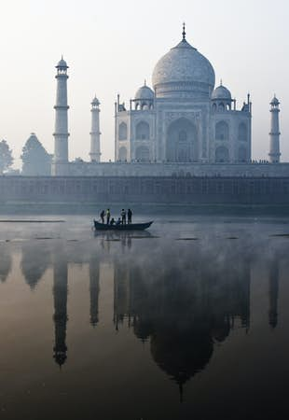
TAJ MAHAL
6
Heading
  There is a new rising star on Europe’s retail horizon. Russia’s grocery market leader X5 Retail Group is on its way to join the ranks of the European Top 10 players. Whereas in 2014 the company was only 22nd in LZ Retailytics’ European retail ranking,
  Heading
  it is expected to become the eighth-largest grocer on the continent by 2022. Over the past years X5 has been overtaking retail heavy-weights such as French Système U, British Morrisons and Swedish ICA Gruppen.
Taj Mahal
Taj was built by Shah Jahan as a memorial for his third wife, Mumtaz Mahal, who died giving birth to their 14th child in 1631. The death of Mumtaz left the emperor so heartbroken that his hair is said to have turned grey virtually overnight. Following his death in 1666,

Slide 7
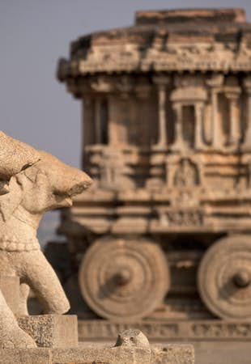
INDIAN CULTURAL DIVERSITY
7
Hampi
Taj Mahal
The magnificent ruins of Hampi dot an unearthly landscape that has captivated travelers for centuries. Heaps of giant boulders perch precariously over miles of undulating terrain, their rusty hues offset by jade-green palm groves, banana plantations and paddy fields.
Taj was built by Shah Jahan as a memorial for his third wife, Mumtaz Mahal, who died giving birth to their 14th child in 1631. The death of Mumtaz left the emperor so heartbroken that his hair is said to have turned grey virtually overnight. Following his death in 1666,
Heading
  Taj was built by Shah Jahan as a memorial for his third wife, Mumtaz Mahal, who died giving birth to their 14th child in 1631. The death of Mumtaz left the emperor so heartbroken that his hair is said to have turned grey virtually overnight. Following his death in 1666,

Slide 8
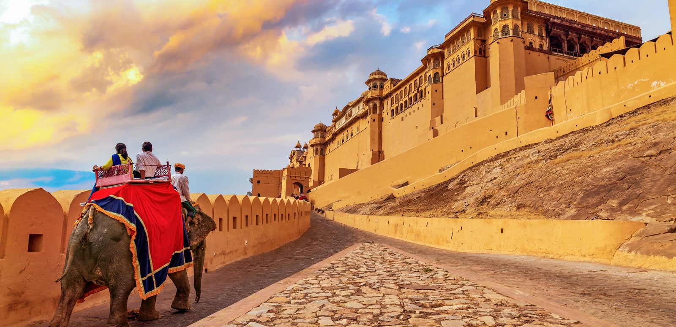

HEADING HERE
COMPARISON POINT 1
COMPARISON POINT 2
The magnificent ruins of Hampi dot an unearthly landscape that has captivated travelers for centuries. Heaps of giant boulders perch precariously over miles of undulating terrain, their rusty hues offset by jade-green palm groves, banana plantations and paddy fields. The magnificent ruins of Hampi dot an unearthly landscape that has captivated travelers for centuries. Heaps of giant boulders perch precariously over miles of undulating terrain, their rusty hues offset by jade-green palm groves, banana plantations and paddy fields.
The magnificent ruins of Hampi dot an unearthly landscape that has captivated travelers for centuries. Heaps of giant boulders perch precariously over miles of undulating terrain, their rusty hues offset by jade-green palm groves, banana plantations and paddy fields. The magnificent ruins of Hampi dot an unearthly landscape that has captivated travelers for centuries. Heaps of giant boulders perch precariously over miles of undulating terrain, their rusty hues offset by jade-green palm groves, banana plantations and paddy fields.

Slide 9
THANKS YOU
9

