Slide 1
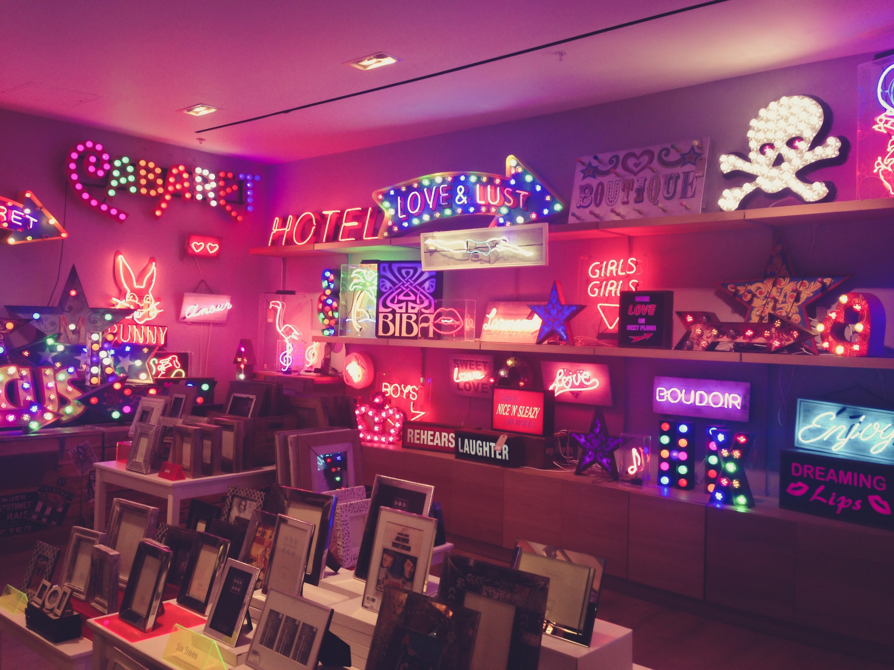
The Negative Effects of Advertising on Society

Slide 2

“Advertising is the art of convincing people to spend money they don’t have for something they don’t need.” ~Will Rogers

Slide 3

3 Main negatives in advertising
Advertising makes us feel that we are not enough as we are
Advertising makes us believe that buying stuff will bring us happiness
Advertising makes us think that everything we need is for sale

Slide 4
1.Advertising makes us feel that we are not enough as we are
You are not beautiful
You are not elegant
You are not confident

Slide 5
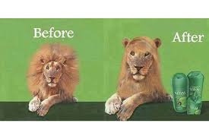
The result is : that our minds take us to :

Slide 6
” Nowadays, about 90 million women in the U.S. color their hair”

Slide 7
2.Advertising makes us believe that buying stuff will bring us happiness
Create an emotional problem then offer you a solution

Slide 8


In short, they promise you happiness , provided that you spend money in return.

Slide 9
3. Advertising makes us think that everything we need is for sale
wrong idea that everything we need is for sale
money should be our prime goal in life
According to (Kilter, Armstrong et el) :Types of promotional pricing
1.Discounts
2. Special-event pricing
3.Cash

Slide 10
In Conclusion
“Advertising: the science of arresting the human intelligence long enough to get money from it.” ~Stephen Leacock

Slide 11
Thank you
Any questions ?

