Slide 1


Slide 2
Overview
Big Blue.
Armonk, New York, United States.
Computer Hardware and Software.
Services.
World’s largest computer company and systems integrator.
Worldwide.
Ranked second.

Slide 3
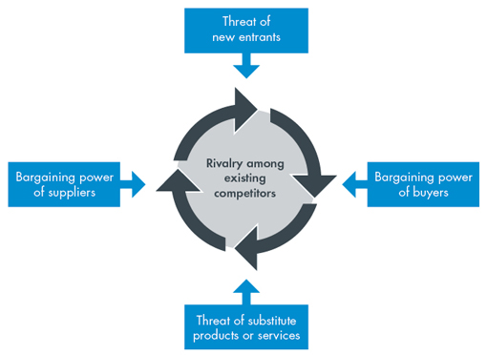
Porter’s Competitive forces model

Slide 4

Management, Organization, and technology created an IS solution
Business problems (decrease in profit and no revenue)

Slide 5

The new IS system used to solve the business problem
Same system: MIS
Improvement
of

Slide 6


The IS objectives achieved after using the new IS
Integrated system
Customer Intimacy

Slide 7


Operational Excellence
Improvement of decision making

Slide 8


The Adaption of the new IS system
How to use DSS.
Training Employees.
Real life situations.
Daily Feedback.

Slide 9

Evaluation & Suggestions
Transferred Data easily and rapidly .
Achieved target in 2 years.
From Hardware to system.

Slide 10

Strength
Weakness
Competitive advantage
Promote learning
Enhance Effectiveness
Organizational control
Better decision making
Information overload
False belief in objectivity
Responsibility
Monetary cost

Slide 11

Suggestion
Offer services with low prices so that IBM manages more services.

