Slide 1
Third Culture Kids

Slide 2




Introduction

Slide 3

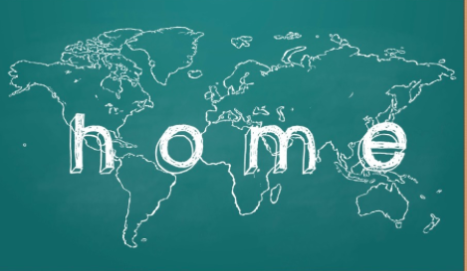
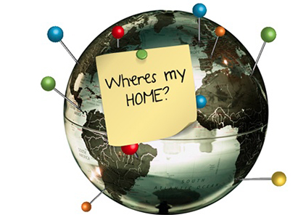
A. What are the third culture kids?
The sociologist David Pollock
Grown in a different culture than their parents
Citizens of everywhere and nowhere
No time to bring out their real identity
Experience it before age of 9

Slide 4

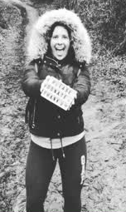
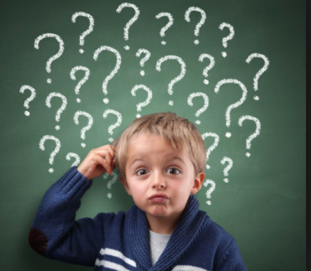

B. struggles of being a TCK
Blandine West, worker at Inter Nations.
Where do u come from?
    Where do they actually fit ?
    Where is their home ?

Slide 5
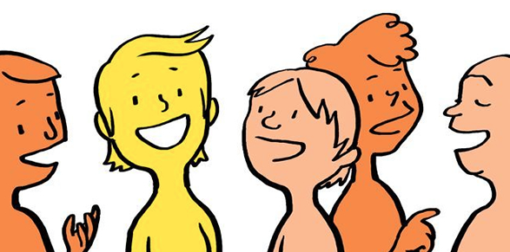


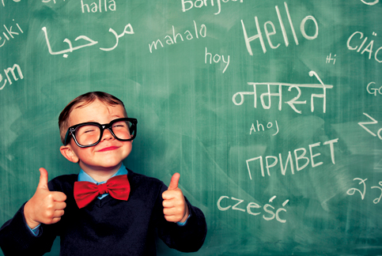
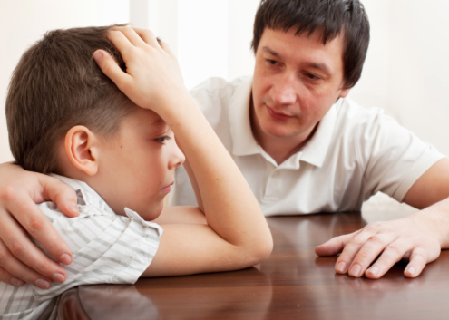
Merging languages
Difficulty in talking
Speak more than just one language

Slide 6
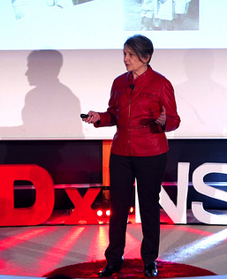


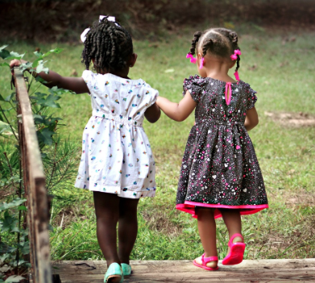

Lost/Struggles of maintaining friendships and connections:
Ruth Van reken

Slide 7
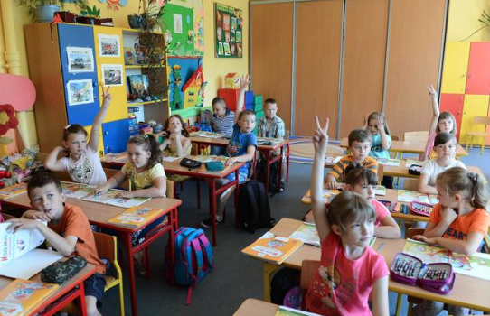
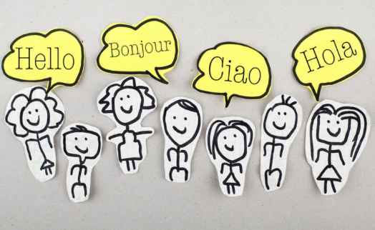

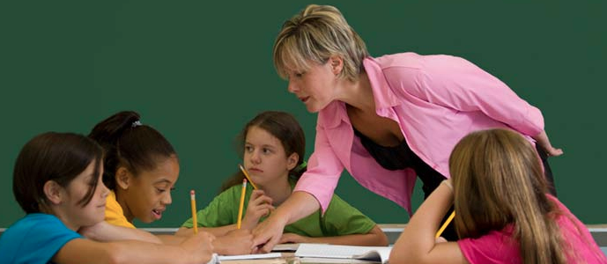
C. Benefits of being a TCK
Educational Opportunities
Education in different countries
Different educational systems
  expands their mind
Aetna

Slide 8
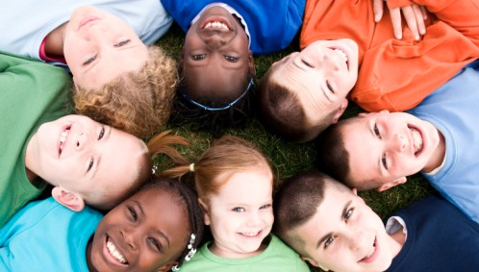
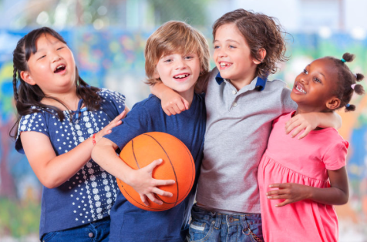

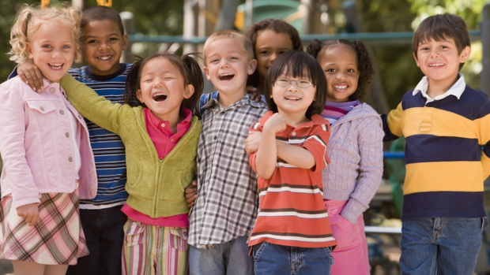
Expansion of social life network

Slide 9
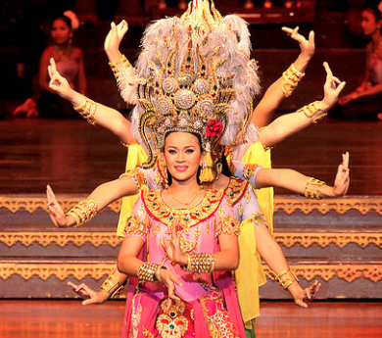

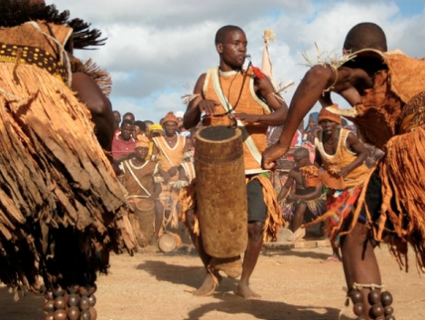
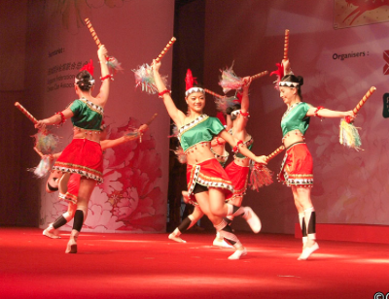
Adaptability
Getting accustomed to the country’s:
  Culture, traditions
Better Accommodation
Better Mingling
Better understanding with others
Dr. Frédéric Braun, a neurologist in Washington

Slide 10
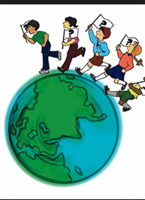
CONCLUSION
Great understanding of Third Culture Kids
Facing the challenges (Mixing languages, Friendships problems, ..)
Earned benefits from the experience (Educational Chances, Better social life, Adapting)

Slide 11
We travel because distance and difference is the secret tonic of creativity.
When we get back home, home is still the same but something inside our minds has changed and that changes everything.
Jonah Lehrer

Slide 12

ANY QUESTIONS?

Slide 13

THANK YOU!

