Slide 1
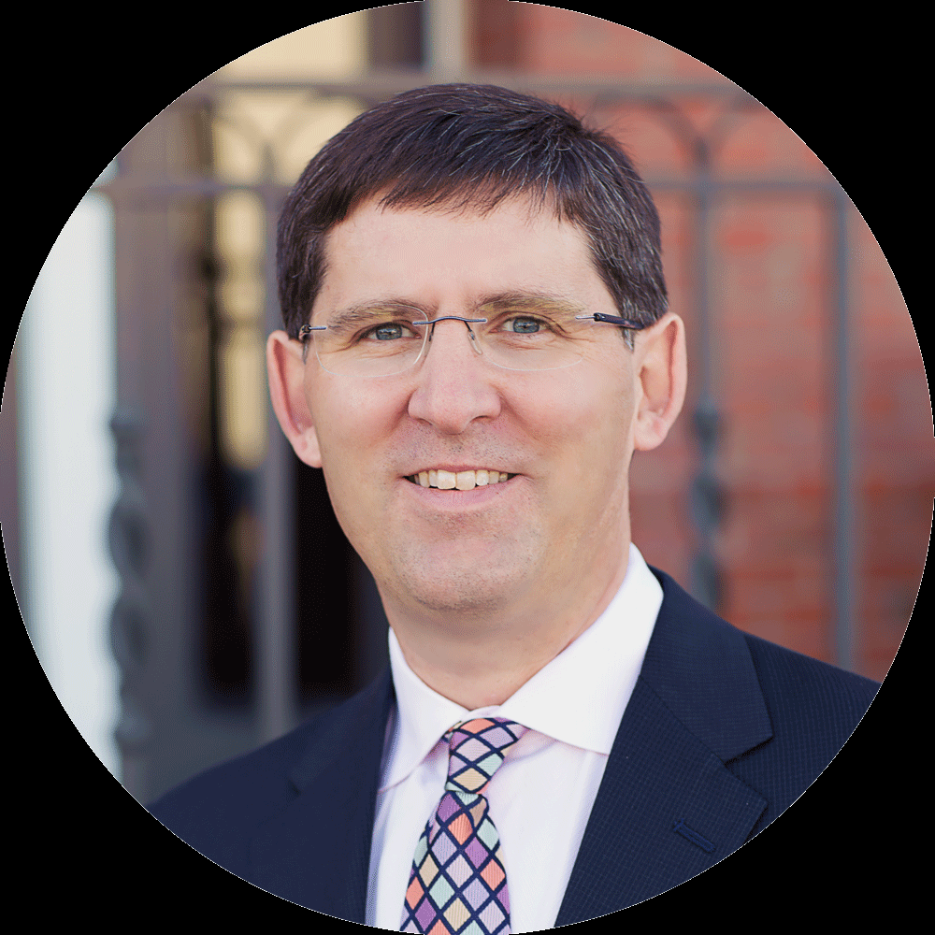
Albert Einstein
Ceo/ founder
A multi-tier blockchain system designed to address unsolved questions of scalability.

Slide 2
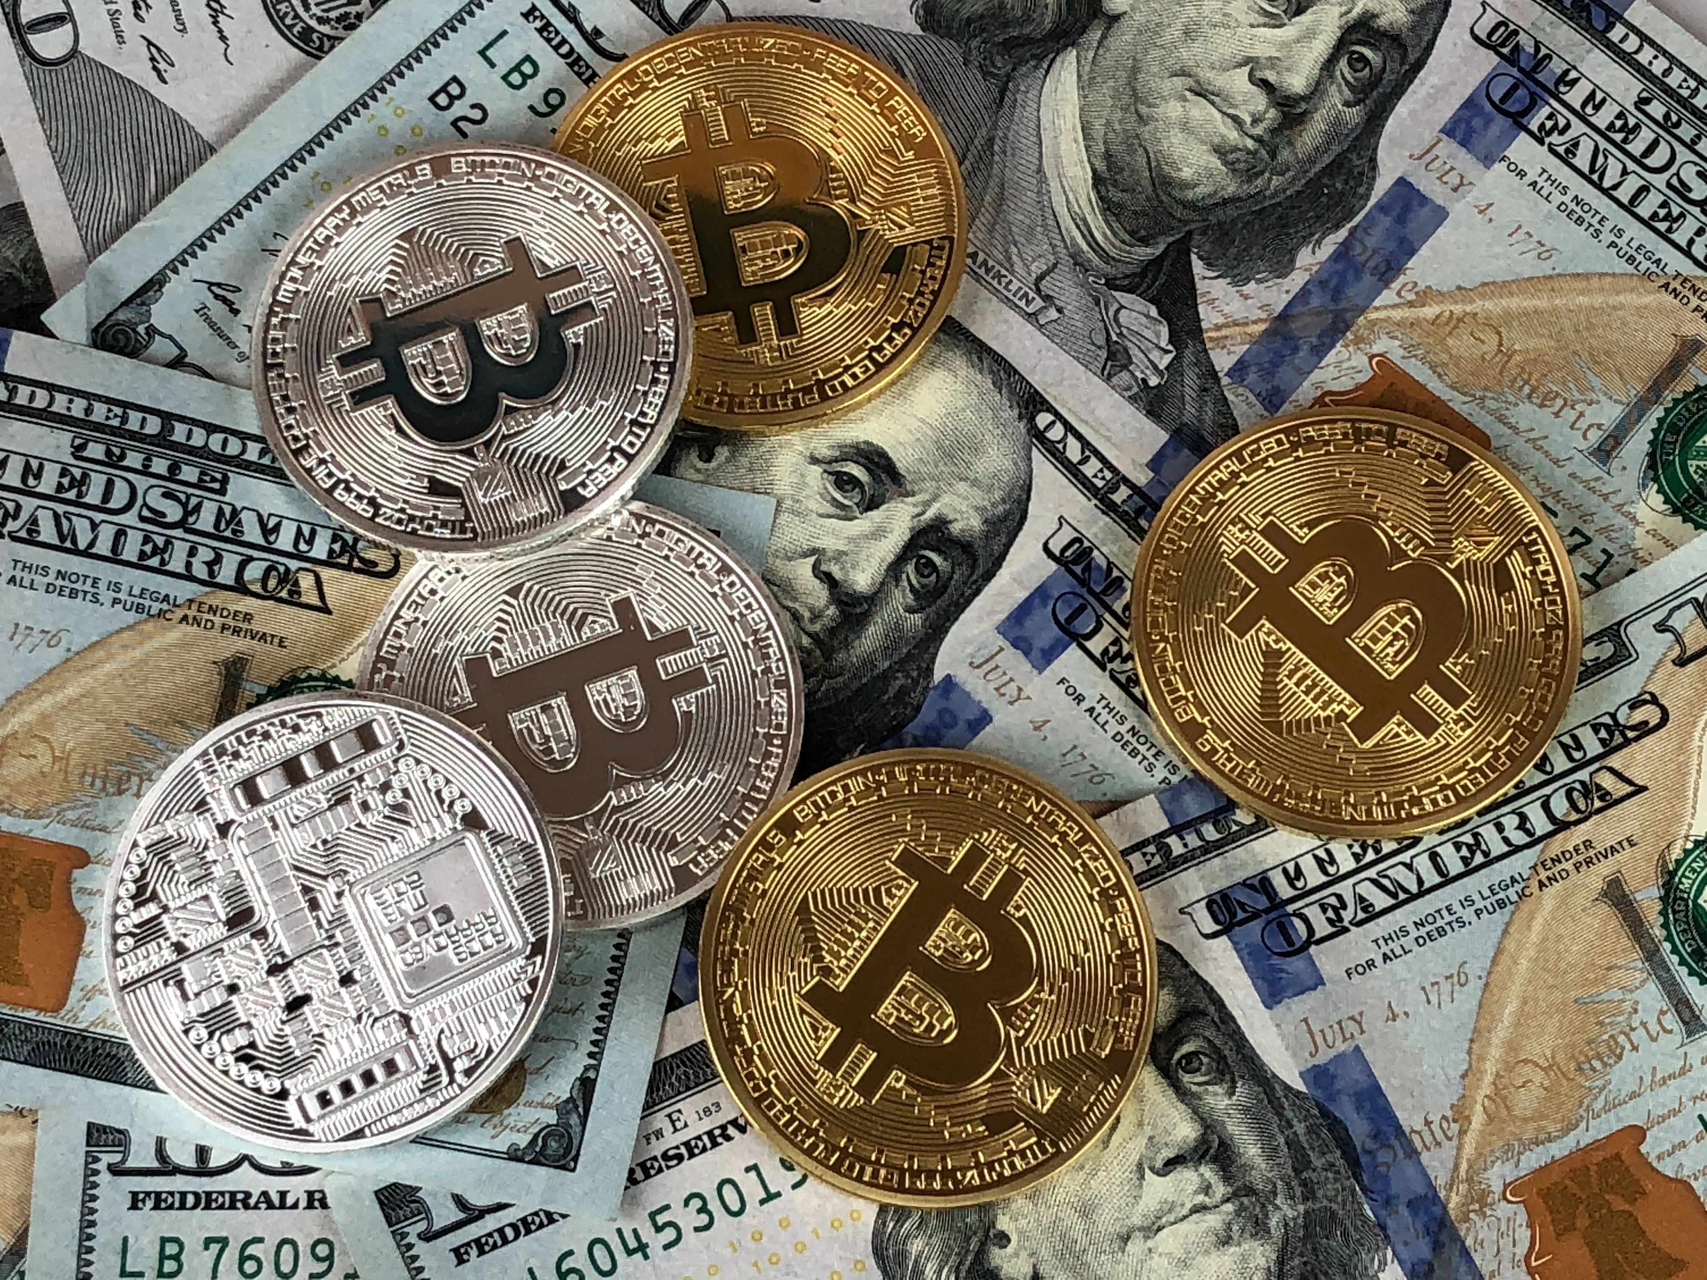
Presentation
Agenda
Introduction
About Crypto
Blockchain Technology
Our Team
Future
Contact
It always does one good. Apparently we had reached a great height in the atmosphere, for the sky was a dead black, and the stars had ceased to twinkle.

Slide 3
The Future of Banking is here #2
Remittances
Sed ut perspiciatis unde omnis iste natus error sit voluptatem accusantium doloremque laudantium.
Future#1
Future#2
Future#3
Remittances
Future
Micro
Payments
Mobile
Branches

Slide 4
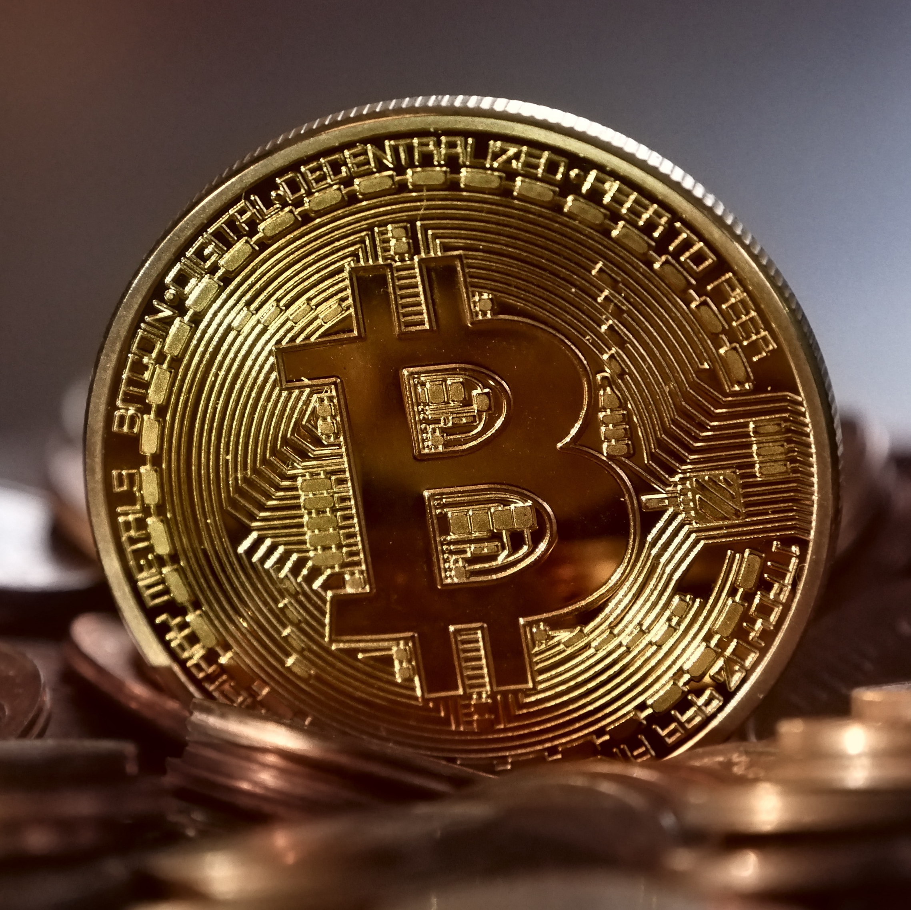
Crowing
Global
Network
80+
Deploying
Commercially
It always does one good. Apparently we had reached a great height in the atmosphere, for the sky was a dead black, and the stars had ceased to twinkle. By the same illusion which lifts the horizon of the sea to the level of the spectator on a hillside, the sable cloud beneath was dished out, and the car seemed to float.
100+
Customers

Slide 5

Our Services
Minimum purchase is 50 Coins tokens. Get a bonus from 5% to 25%
Digital Assets
Digital Identity
Smart Contract
Sed ut perspiciatis unde omnis iste natus error sit voluptatem accusantium doloremque laudantium.
Sed ut perspiciatis unde omnis iste natus error sit voluptatem accusantium doloremque laudantium.
Sed ut perspiciatis unde omnis iste natus error sit voluptatem accusantium doloremque laudantium.

Slide 6
Crypto monitoring
252
12
123
Transactions in last 24h
Transactions per hour
Largest Transactions
Sed ut perspiciatis unde omnis iste natus error sit voluptatem accusantium doloremque laudantium.
Sed ut perspiciatis unde omnis iste natus error sit voluptatem accusantium doloremque laudantium.
Sed ut perspiciatis unde omnis iste natus error sit voluptatem accusantium doloremque laudantium.

Slide 7
Our Latest In Numbers
Minimum purchase is 50 Coins tokens. Get a bonus from 5% to 25%
800
Blockchain
Sed ut perspiciatis unde omnis iste natus.
340
Crypto
Sed ut perspiciatis unde omnis iste natus.
391
Federate
Sed ut perspiciatis unde omnis iste natus.
5M
Scale
Sed ut perspiciatis unde omnis iste natus.

Slide 8
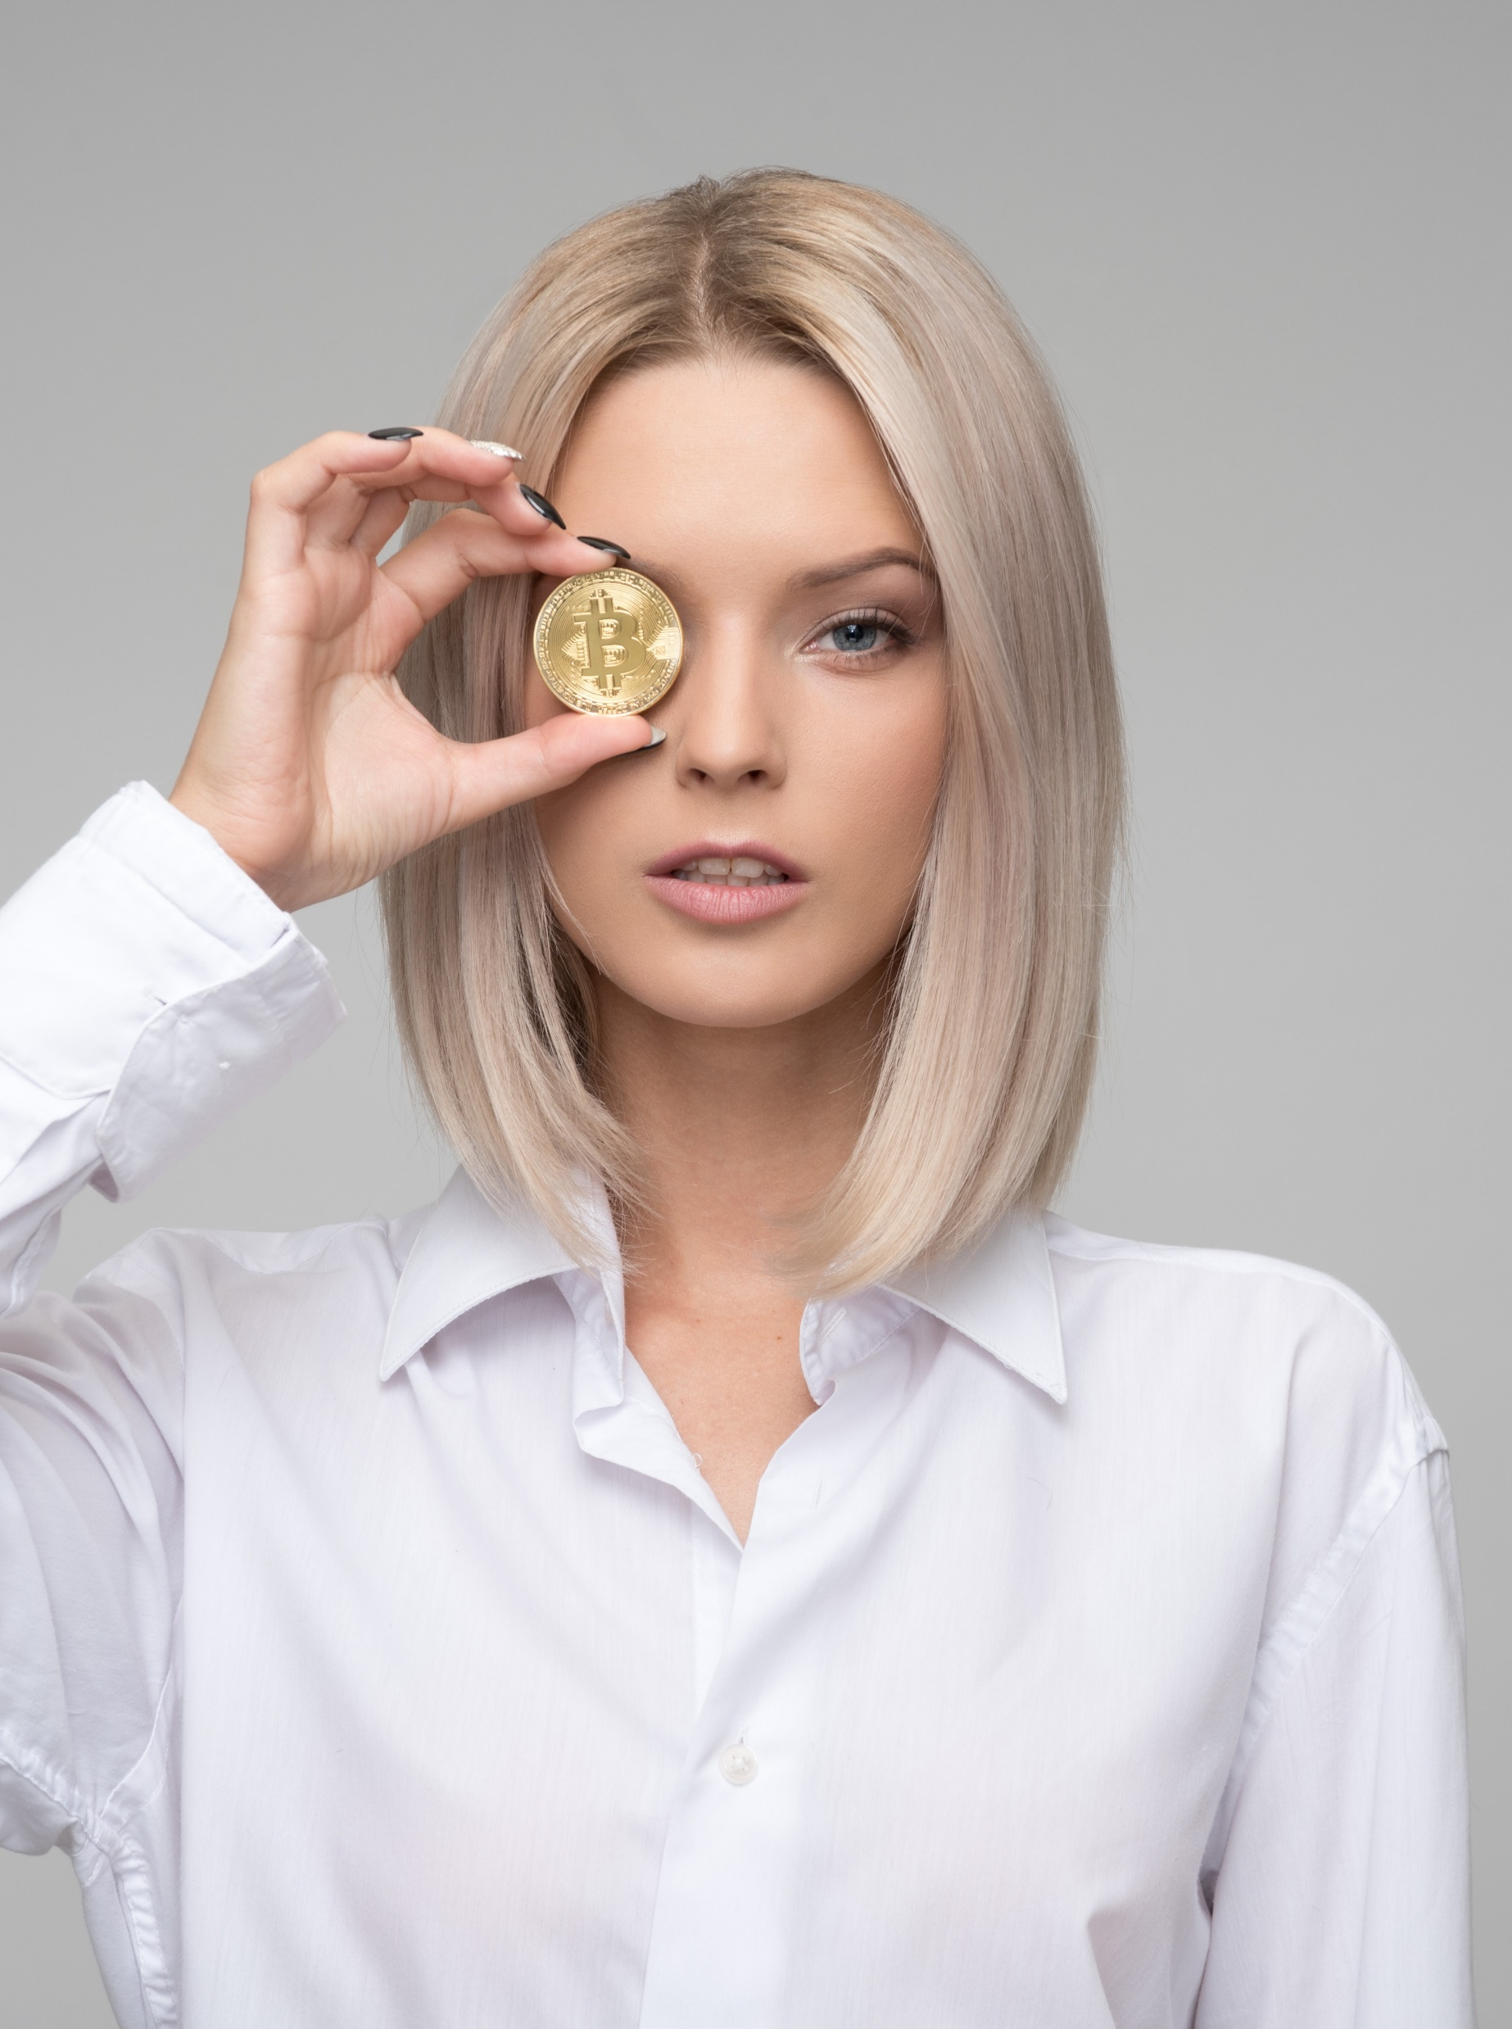
What does
Populous Provide?
CRYPTO TEXT HERE
A peep at some distant orb has power to raise and purify our thoughts like a strain of sacred music, or a noble picture, or a passage from the grander poets. It always does one good.
Apparently we had reached a great height in the atmosphere, for the sky was a dead black, and the stars had ceased to twinkle. By the same illusion which lifts the horizon of the sea to the level of the spectator on a hillside, the sable cloud beneath was dished out, and the car seemed to float in the middle of an immense dark sphere, whose upper half was strewn with silver. Apparently we had reached a great height in the atmosphere, for the sky was a dead black, and the stars had ceased to twinkle.

Slide 9
Better
Blockchain
Technology
Bulleted List #1
A peep at some distant orb has power to raise and purify our thoughts like a strain of sacred music.
Bulleted List #2
Apparently we had reached a great height in the atmosphere, for the sky was a dead black, and the stars had ceased to twinkle. By the same illusion which lifts the horizon of the sea to the level of the spectator on a hillside, the sable cloud beneath.
SAMPLE TEXT
Bulleted List #3
A peep at some distant orb has power to raise and purify our thoughts like a strain of sacred music, or a noble picture.
A peep at some distant orb has power to raise and purify our thoughts like a strain of sacred music.

Slide 10
Better Blockchain Technology
Minimum purchase is 50 Coins tokens. Get a bonus from 5% to 25%
Bulleted List #1
Bulleted List #2
Bulleted List #3
A peep at some distant orb has power to raise and purify our thoughts like a strain of sacred music.
Apparently we had reached a great height in the atmosphere, for the sky was a dead black, and the stars had ceased to twinkle. By the same illusion which lifts the horizon.
A peep at some distant orb has power to raise and purify our thoughts like a strain of sacred music.

Slide 11


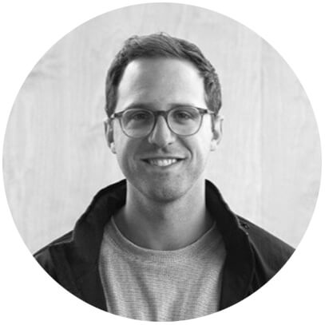

Our Team
Minimum purchase is 50 Coins tokens. Get a bonus from 5% to 25%
Blaise Pascal
Martha Jenny
Edwin Powell Hubble
Jane Goodall
General Director
Regional Manager
Assistant Manager
Assistant Manager

Slide 12
Numbers Service Crypto
Minimum purchase is 50 Coins tokens. Get a bonus from 5% to 25%
01
02
03
Remittances
Digital Assest
Remittances
A peep at some distant orb has power to raise and purify our thoughts like a strain of sacred music, or a noble picture, or a passage from the grander poets. It always does one good.
A peep at some distant orb has power to raise and purify our thoughts like a strain of sacred music, or a noble picture, or a passage from the grander poets. It always does one good.
A peep at some distant orb has power to raise and purify our thoughts like a strain of sacred music, or a noble picture, or a passage from the grander poets. It always does one good.

Slide 13
Federate
Scale
Multiple bridges between pairs
Product Release
Pre-designed layout options
Multiple bridges between pair
Product Release
Pre-designed layout options
Cloud network
There are many variations of passages of lorem.
Spoke
Responsive
Multiple bridges between pairs
Product Release
Pre-designed layout options
Multiple bridges between pairs
Product Release
Pre-designed layout options

Slide 14
Circle chart
Minimum purchase is 50 Coins tokens. Get a bonus from 5% to 25%
75%
50%
25%
25%
Crowdfunding
Crypto
Blockchain
Blockchain
Sed ut perspiciatis unde omnis iste natus error sit voluptatem accusantium laudantium.
Sed ut perspiciatis unde omnis iste natus error sit
Sed ut perspiciatis unde omnis iste natus error sit
Sed ut perspiciatis unde omnis iste natus error sit

Slide 15
Pyramid
Infographic
Write title here
A peep at some distant orb has power to raise and purify.
01
Write title here
A peep at some distant orb has power to raise and purify.
02
A peep at some distant orb has power to raise and purify our thoughts like a strain of sacred music, or a noble picture, or a passage from the grander poets. It always does one good. Apparently we had reached a great height in the atmosphere, for the sky was a dead black, and the stars had ceased to twinkle.
Write title here
A peep at some distant orb has power to raise and purify.
03
Write title here
A peep at some distant orb has power to raise and purify.
04

Slide 16
Process infographic
01
02
03
04
05
Write title here
A peep at some distant orb has power to raise and purify.
Write title here
A peep at some distant orb has power to raise and purify.
Write title here
A peep at some distant orb has power to raise and purify.
Write title here
A peep at some distant orb has power to raise and purify.
Write title here
A peep at some distant orb has power to raise and purify.

Slide 17
Crypto live price tables
Minimum purchase is 50 Coins tokens. Get a bonus from 5% to 25%
Symbol | Name | USD | Change 1h | Change 24h | Change 7d
BTC | Bitcoin | 11,509 | -0.55% | -0.55% | -0.55%
ETH | Ethereum | 1,065 | -0.32% | -0.32% | -0.32%
XRP | Ripple | 1.231 | -0.23% | -0.23% | -0.23%
LTC | Litecoin | 181.5 | -0.1% | -0.1% | -0.1%
XMR | Monero | 325.3 | +0.3% | +0.3% | +0.3%

Slide 18
Stacked
Chart
Style
Crypto title text
A peep at some distant orb has power to raise and purify our thoughts like a strain of sacred music, or a noble picture.

Slide 19
Pie
Chart
Style
Crypto title text
A peep at some distant orb has power to raise and purify our thoughts like a strain of sacred music, or a noble picture.

Slide 20
Laptop
Device
Slide
Crypto title text
A peep at some distant orb has power to raise and purify our thoughts like a strain of sacred music, or a noble picture.

Slide 21
Phone
Device
Slide
$500B
Phone Screen
A peep at some distant orb has power to raise and purify our thoughts.

Slide 22
World
Map
30%
58%
Russia
90%
75%
Europe
North America
China
Crypto text here
A peep at some distant orb has power to raise and purify our thoughts like a strain of sacred music, or a noble picture.

Slide 23
USA Chart
Slides
$500B
New York
A peep at some distant orb has power to raise and purify our thoughts.
$340B
New York
A peep at some distant orb has power to raise and purify our thoughts.

Slide 24
THANK YOU
A peep at some distant orb has power to raise and purify our thoughts like a strain of sacred music, or a noble picture.

Slide 25
BLOCKCHAIN TECH
POWERPOINT TEMPLATE
Aa
FONT: MONTSERRAT
DOWNLOAD
COLOR PALETTE

