Slide 1
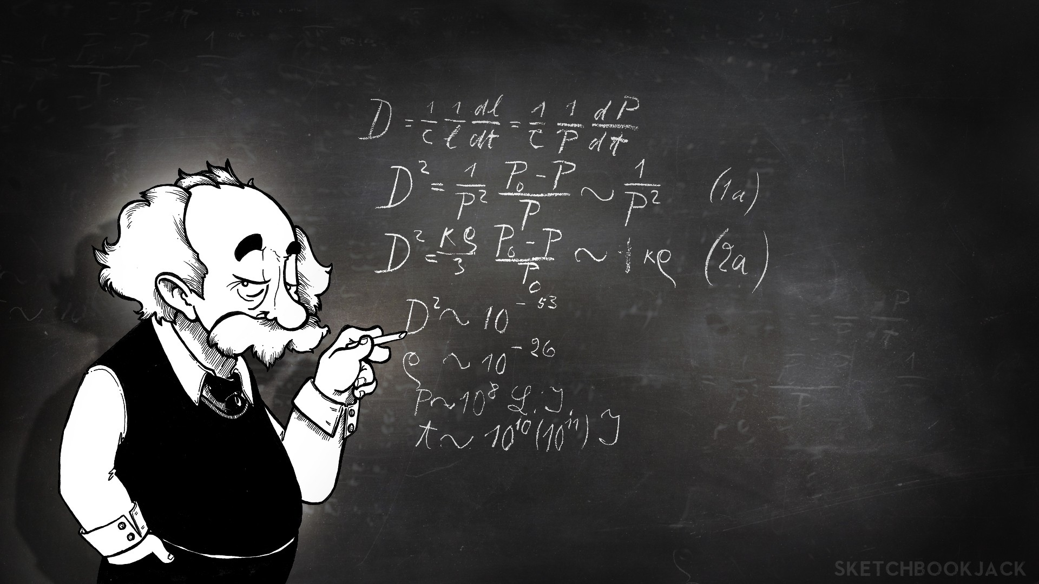
Effects of forces

Slide 2

Newton’s Second Law
Starting , stopping , getting faster or slower are all changes in motion (acceleration).
Resultant Force is determined using the following formula
(Net force = Driving force – Resisting force)
Newton’s second Law : The acceleration of a body is directly proportional the net force acting on the body provided the mass remains constant
Equation : F=ma
F : Force , m : mass ,a : acceleration

Slide 3
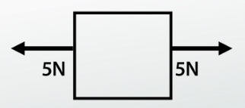
The effect of a zero net force
This happens when the driving force = Resisting force
If the object is at rest it will stay at rest
If the object is moving it will keep moving with constant speed
Net Force = Zero
Acceleration = Zero

Slide 4
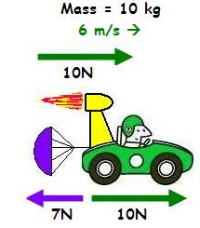
The effect of a POSITIVE net force
This happens when Driving forces is greater than Resisting forces
Or the there is Driving force with no resisting forces
Object will accelerate (gain speed)
Net Force = Positive
Acceleration = Positive

Slide 5
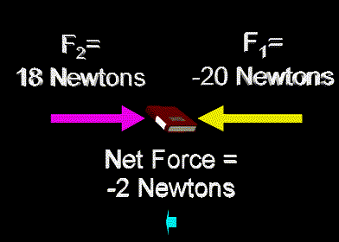
The effect of a NEGATIVE net force
This happens when the driving force is less than the resisting force
Or there is resisting force with no driving Force
Object will decelerate (loose speed)
Net Force = Negative
Acceleration = Negative

Slide 6
Force acting perpendicular to direction of motion
As seen before a force can cause a velocity to change by changing the speed of an object .
Force can cause velocity to change by changing the direction of an object .
Its neither a driving nor resisting force it acts as a Centripetal force
Centripetal force :inward force needed to make an object move in a circular motion

Slide 7

Forces and Deformation
When a force is applied on an object and causes a change in it shape we say it has experienced deformation .
There are two types of deformation:
Elastic deformation
Plastic deformation

Slide 8

Elastic deformation
When an object experiences a change In shape it returns to its original shape as soon as the force is removed .
Examples:
Stretching rubber bands
Squeezing a tennis ball

Slide 9

Plastic Deformation
When an object experiences a change in shape and does not return to the original shape when the deforming force is removed
This means this object has exceeded its elastic limit that’s why it didn’t return to its original shape

Slide 10
Hooke’s Law
Hooke’s law : The extension is directly proportional to the stretching force provided that the limit of proportionality is not exceeded
Extension = Stretched length – Unstretched Length
Equation : F=Ke
F:Forec, K:stiffnes of the string , e : extension

Slide 11
THANK YOU

