Slide 1

PRESENTATION TEMPLATE

Slide 2


INSTRUCTIONS FOR USE
Open this document in Google Slides, or click on the button “use this template”. To do this you must be logged in with your google profile.
EDIT IN GOOGLE SLIDES
Open File menu and select make a copy.
That will open a copy of this template in your google drive you can edit, add or delete.
EDIT IN POWERPOINT
Open File menu and select Download as a Microsoft Powerpoint. You will download a PPTX file that you can edit in Powerpoint.
For further information, go to www.slidespower.com

Slide 3





My name: NAME & SURNAME
Email: slidespower@gmail.com
Phone: (+31) 123 45 67 89

Slide 4

Title to introduce the following slides

Slide 5

To get a good presentation is essential to make a good design of the slides, this help us to communicate our message in a clear and simple way and thus guarantee to the success of the presentation.

Slide 6

TOPICS TO TALK ABOUT
Choose a clean background to avoid distracting.
Transmit only one idea per slide .
Do not overload slides, just 6 or 7 lines.
Each line no more than 7 words.
It is preferable that the audience listen to your, rather that read to the presentation.

Slide 7

THE IDEA
Define the main idea that will be the focus of your presentation.
Use icons or illustrations to attract the attention of your audience.

Slide 8

Citizens: 850.000
Mobile users: 80 %
Profit: 200 Million $
THE MARKET

Slide 9

TWO COLUMNS TEXT
Text Size
The text should be readable from the end of the auditorium, so choose a well readable font and use a minimum size of 24.
Margins around the text
The texts, images or graphics should not be next to the edge of the slide. The edges should be wide around the texts.

Slide 10


INFOGRAPHIC DIAGRAM
Less is More.
The less information you give, better remember your audience. Create shorts and concise messages.
Less is More.
The less information you give, better remember your audience. Create shorts and concise messages.
Less is More.
The less information you give, better remember your audience. Create shorts and concise messages.

Slide 11
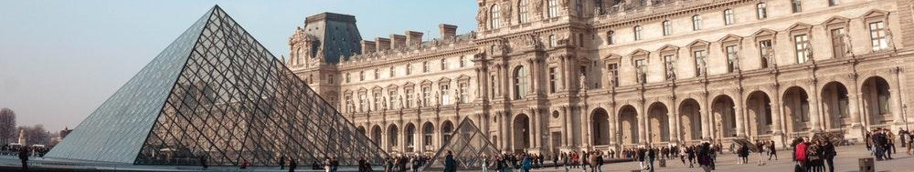
THREE COLUMNS TEXT
Less is more
Use the contrast
Use a good template
The less information you give, better remember your audience. Create shorts and concise messages.
The contrast gives you the option to call attention to what you want to highlight. Use the size, colour, composition.
You must choose a template that suits the type of work your are about to submit.

Slide 12
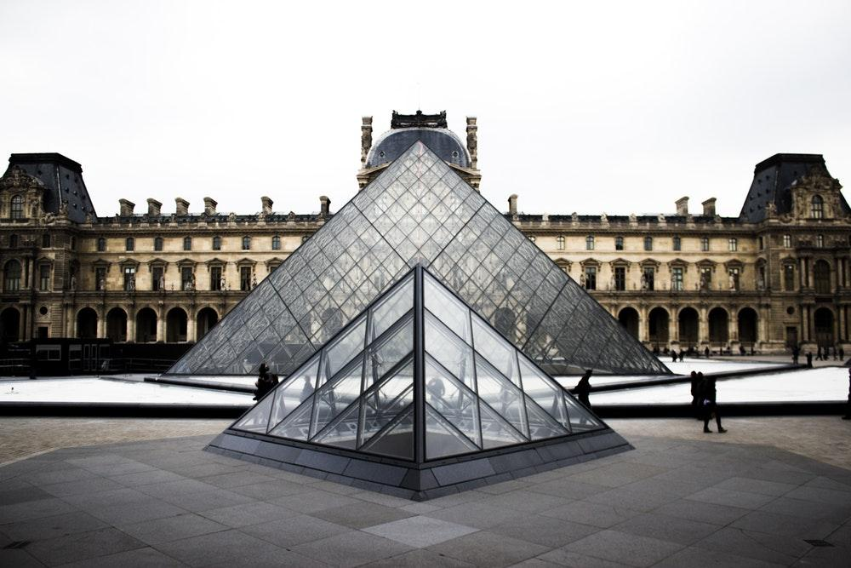
USE OF IMAGES
A good image in your presentation is worth a thousand words.
Choose good themes for your presentations.

Slide 13
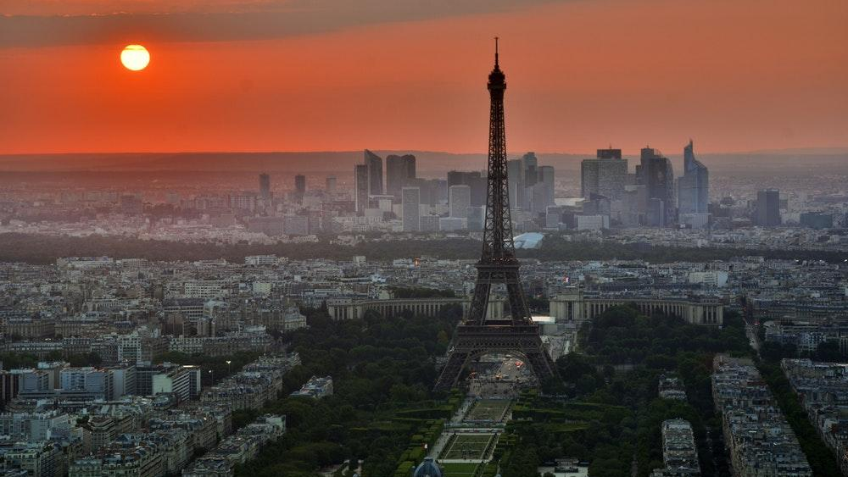
With a good image you can explain a complex concept in a simple way.

Slide 14

USE OF TABLES
 | CAPITAL | INHABITANTS (Millions) | CURRENCY
MÉXICO | CIUDAD DE MÉXICO | 122 | PESO
USA | WASHINGTON | 270 | DOLLAR
GERMANY | BERLIN | 82 | EURO
The tables are very useful for displaying information ordered.

Slide 15



USE CHARTS
Graphics help us to understand the relationships between numerical values.

Slide 16




USE OF CHARTS
You can insert charts from Google Sheets

Slide 17

FLOW CHARTS (Process)
Flowcharts are used to graphically represent the flow or sequences of simple routines.
1
2
3
4
5
6

Slide 18


MAPS

Slide 19

TECHNOLOGY PRESENTATION
Below we provide a set of slides for your Apps or Web presentations.

Slide 20




Introduce your app using this template.
You can change the picture or introduce a text.

Slide 21



Introduce your app using this template.
You can change the picture or introduce a text.

Slide 22


TABLETS
Introduce your app using this template.
You can change the picture or introduce a text.
www.slidespower.com

Slide 23

FINAL CONCLUSSIONS
TYPE
It is important to use fonts that read well, without being in bold. Example: helvética.
DESIGN
A well-designed template is an ideal way to communicate a message simply and clearly.
TIME PER SLIDE
In a quality slideshow, the time of exposure should not exceed 30 seconds.
PREPARATION
Out of respect for the audience, it is essential to prepare well the presentation and try not to leave anything to chance.
We proceed to make a summary of the main points discussed in the presentation.

Slide 24

Thank
you

Slide 25
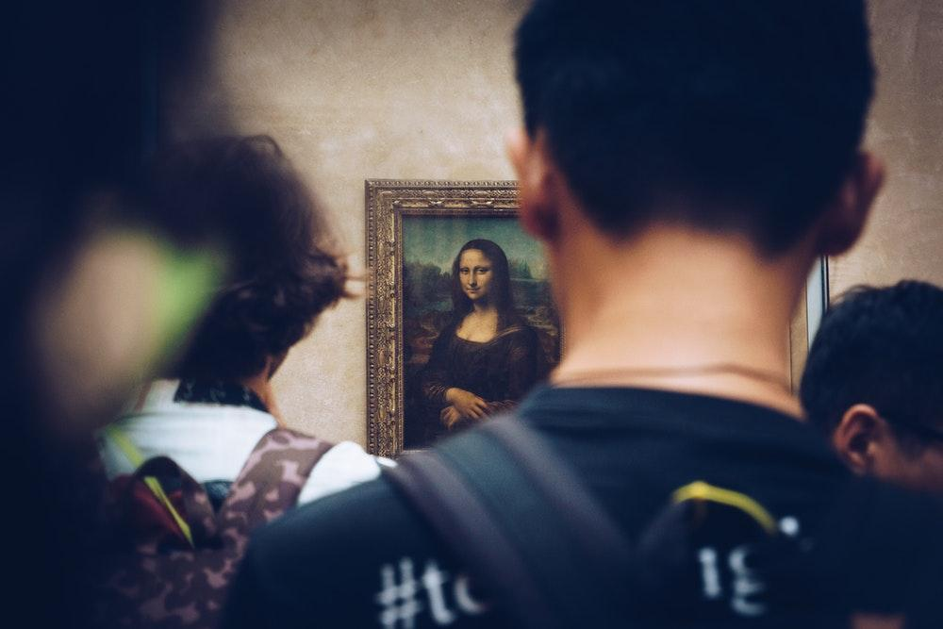
BIBLIOGRAPHY
Google Images.
Prof. Reynel A. Llanes Belett.
Google Images.
Prof. Reynel A. Llanes Belett.

Slide 26

PRESENTATION DESIGN
FONTS:
Jacques Francois
IMAGES:
www.pixabay.com
www.unsplash.com
ICONS:
www.iconfinder.com
DESIGNED BY:
www.slidespower.com

