Slide 1

¡HAPPY HALLOWEEN!

Slide 2


INSTRUCTIONS FOR USE
Open this document in Google Slides, or click on the button “use this template”. To do this you must be logged in with your google.
EDIT IN GOOGLE SLIDES
Open File menu and select make a copy.
That will open a copy of this template in your google drive you can edit, add or delete.
EDIT IN POWERPOINT
Open File menu and select Download as a Microsoft Powerpoint. You will download a PPTX file that you can edit in Powerpoint.
For further information, go to www.slidespower.com

Slide 3





My Name: Name & Surname
My email: slidespower@gmail.com
Phone: (+31) 123 45 67 89

Slide 4

TITLE TO INTRODUCE
THE FOLLOWING SLIDES

Slide 5

Eat, drink and fun
Define the main idea that will be the focus of your presentation, and use icons or illustrations to attract the attention of your audience.

Slide 6

HOW TO MAKE A GOOD PRESENTATION
To get a good presentation is essential to make a good design of the slides, this help us to communicate our message in a clear and simple way and thus guarantee to the success of the presentation.

Slide 7

TIPS TO TALK ABOUT
Choose a clean background to avoid distracting.
Transmit only one idea per slide .
Do not overload slides, just 6 or 7 lines.
Each line no more than 7 words.
Is preferable that the audience listen to you, rather that read to the presentation.

Slide 8

132.000.000 Citizens
80 % Turkey Consumers
PROFIT: 2.640 MillIons $
THE MARKET

Slide 9

TEXT SIZE
MARGINS AROUND THE TEXT
The text should be readable from the end of the auditorium, so choose a well readable font and use a minimum size of 24.
The texts, images or graphics should not be next to the edge of the slide. The edges should be wide around the texts.

Slide 10

INFOGRAPHIC DIAGRAM
Less is more
The less information you give, better remember your audience. Create shorts and concise messages.
Use the contrast.
The contrast gives you the option to call attention to what you want to highlight. Use the size, colour, composition.
Use a good template.
You must choose a template that suits the type of work your are about to submit.

Slide 11

USE IMAGES
A good image in your presentation is worth a thousand words.
Choose good themes for your presentations.

Slide 12

With a good image you can explain a complex concept in a simple way.

Slide 13

USE TABLES
The tables are very useful for displaying information ordered.
 | CAPITAL | HABITANTES (MILLONES) | MONEDA
MÉXICO | CIUDAD DE MÉXICO | 122 | PESO
U.S.A | WASHINGTON | 270 | DOLAR
ALEMANIA | BERLIN | 82 | EURO

Slide 14

USE CHARTS
Graphics help us to understand the relationships between numerical values.

Slide 15

USE CHARTS
You can insert graphs from Google Sheets

Slide 16

FLOW CHARTS (PROCESS)
Flowcharts are used to graphically represent the flow or sequences of simple routines.
1
2
3
4
5
6
7
8

Slide 17
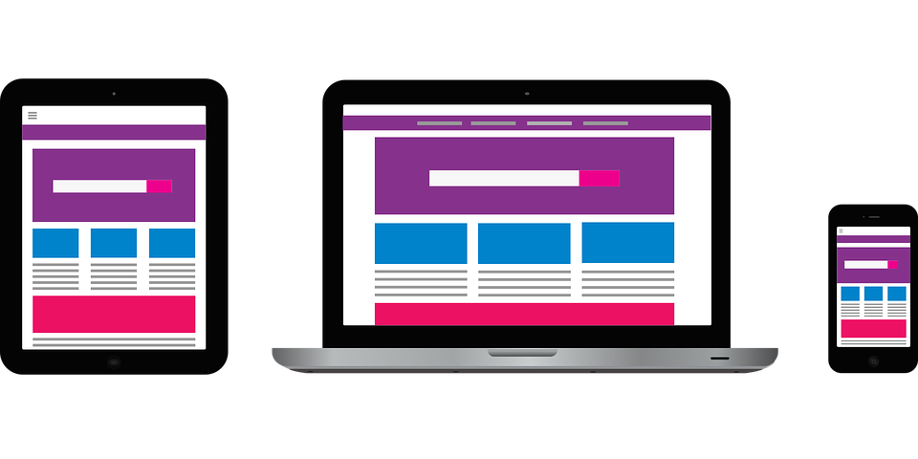
TECHNOLOGY PRESENTATION
Below we provide a set of slides for your Apps or Web presentations.

Slide 18



Introduce your app using this template.
You can change the picture or introduce a text.

Slide 19


Introduce your app using this template.
You can change the picture or introduce a text.

Slide 20

TABLETS
Introduce your app using this template.
You can change the picture or introduce a text.
www.slidespower.com

Slide 21

CONCLUSIONS
FONTS
It is important to use fonts that read well, without being in bold. Example: helvética.
DESIGN
A well-designed template is an ideal way to communicate a message simply and clearly.
TIME PER SLIDE
In a quality slideshow, the time of exposure should not exceed 30 seconds.
PREPARATION
Out of respect for the audience, it is essential to prepare well the presentation and try not to leave anything to chance.
We proceed to make a summary of the main points discussed in the presentation.

Slide 22
Thank
you

Slide 23

The art of presentation
Google Images.
Prof. Reynel A. Llanes Belett.
The art of presentation
Google Images.
Prof. Reynel A. Llanes Belett.a
Bibliography

Slide 24

PRESENTATION DESIGN
FONTS Arapey
IMAGES:
www.pixabay.com
ICONS:
www.iconfinder.com
DESIGN BY
www.slidespower.com

