Slide 1

PRESENTATION
OF PROJECTS
TO INVESTORS

Slide 2




INSTRUCTIONS FOR USE
Open this file on Google Slides, or click on the button below “use this template”.
To be able to do this you must be logged with your Google account.
EDIT IN GOOGLE SLIDES
Go to FIle menu and choose ‘make a copy’.
That will be open a copy of this template in your Google Drive where you can edit, add or delete slides.
EDIT IN POWERPOINT
Go to File menu and choose Download as Microsoft Powerpoint.
That will download a pptx file that you can edit in Powerpoint software.
For further information, go to www.slidespower.com

Slide 3
PROFESSIONAL PRESENTATION SCRIPT
Problem and opportunity.
Value proposal.
The key to your product or service.
Prototype or Demo.
Business model.
Competition analysis.
Financial projections and main metrics.
Current status, current achievements and destination of funding.

Slide 4

PROBLEM AND OPPORTUNITY
Describe the need that you are going to satisfy.
The goal is for everyone to be convinced of the usefulness of the project.

Slide 5
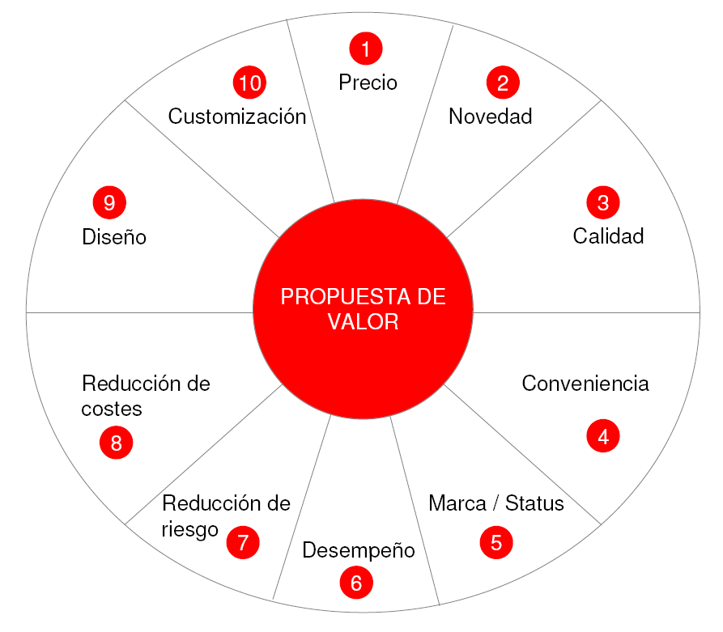
VALUE PROPOSAL
Explain how do you satisfy that need and the meaning of the product.
Be sure to the audience understand the product you are selling: its value proposal.
Do not get into technical issues, that is not the moment. “We offer free presentation templates”

Slide 6

TELL THE KEY TO YOUR PRODUCT
Describe the technology that you are going to use or the way to get it.
Use little text and many images, schemes, flow diagrams, etc...

Slide 7

PROTOTYPE OR DEMO
If you have a prototype or a demo version, it is time to show it. That makes that the presentation goes to a second level of relevance.
To get a prototype is a definitive step to understand the product.

Slide 8
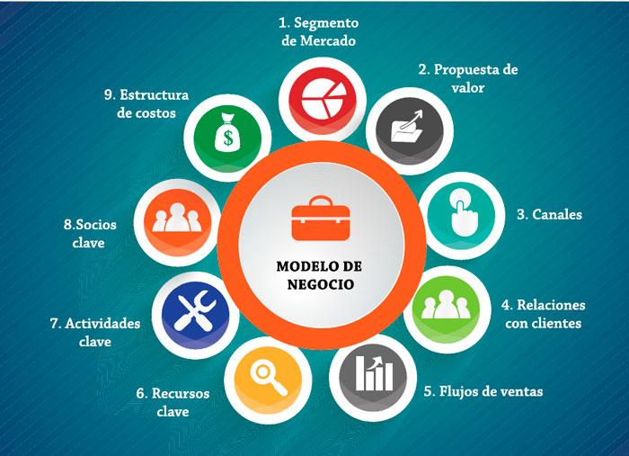
BUSINESS MODEL
Explain how do you earn -or are you going to earn- money with this product.
Who pays, the distribution ways and gross margins.
n the market that use the same model, say their names, a unique business model can be scary...

Slide 9
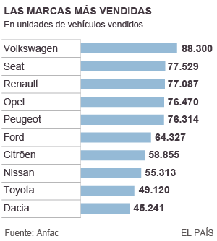
COMPETITION ANALYSIS
Offer a picture of the market as accurate as possible with all competitors.
Facing investors, ignoring the market is critic.

Slide 10
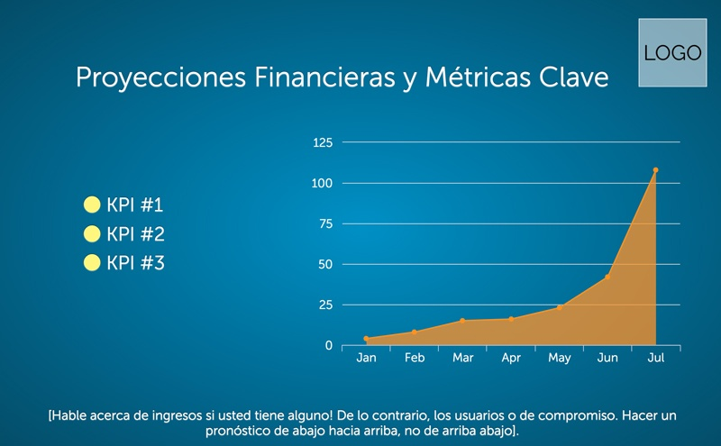
FINANCIAL PROJECTIONS AND MAIN METRICS
Present a prediction to 3 or 5 years that shows another metrics like number of clients or conversion rate besides the money.

Slide 11

CURRENT STATUS, CURRENT ACHIEVEMENTS AND DESTINATION OF FUNDING
Tell in which step the product is, how you see the near future, and how you are going to allocate the funding you get.

Slide 12
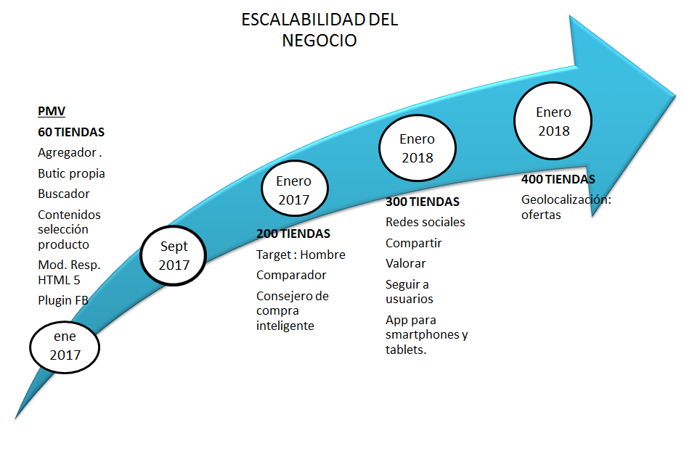
CONCLUSIONS
We will proceed to make a summary of the main points discussed in the presentation.

Slide 13
Thanks
Slidespower@gmail.com

Slide 14
PRESENTATION DESIGN
ICONS:
www.iconfinder.com
PRESENTATION DESIGN
www.slidespower.com
TYPO::
Droid Serif
PICTURES:
www.pixabay.com
google images

Slide 15
www.slidespower.com

