Slide 1
This is your Christmas presentation

Slide 2
Instructions for use
EDIT IN GOOGLE SLIDES
Click on the button under the presentation preview that says "Use as Google Slides Theme".
You will get a copy of this document on your Google Drive and will be able to edit, add or delete slides. You have to be signed in to your Google account.
EDIT IN POWERPOINT®
Click on the button under the presentation preview that says "Download as PowerPoint template". You will get a .pptx file that you can edit in PowerPoint.
Remember to download and install the fonts used in this presentation (you’ll find the links to the font files needed in the Presentation design slide)
More info on how to use this template at www.slidescarnival.com/help-use-presentation-template
To the extent possible under law, http://www.slidescarnival.com has waived all copyright and related or neighboring rights to Christmas 2018 template

Slide 3
Hello! I am Rudolf
I’ve come a long way to bring you this presentation. You can find me at @northpole

Slide 4
Ho ho ho
Let’s start with the first set of slides

Slide 5
Quotations are commonly printed as a means of inspiration and to invoke philosophical thoughts from the reader.
Fa la la la la, la la la la.

Slide 6
This is a festive title
Here you have a list of items
And some text
But remember not to overload your slides with content
Oh! what fun it is to ride in a one-horse open sleigh.

Slide 7
Rejoice!
Bring the attention of your audience over a key concept using icons or illustrations

Slide 8
And tables to compare data
 | Dec 23rd | Dec 24th | Dec 25th
Cookies | 10 | 20 | 7
Carols | 30 | 15 | 10
Gifts | 5 | 24 | 16

Slide 9
You can also split your joyful content
Gingerbread
Is a sweet food-product flavored with ginger and typically using honey or molasses (treacle) rather than just sugar.
Candy cane
Is a cane-shaped hard candy stick associated with Christmas. It is traditionally white with red stripes but is also made in a variety of other colors.

Slide 10
In two or three merry columns
Apple cider
This untreated cider is a seasonally produced drink of limited shelf-life that is typically available only in fall, although it is sometimes frozen for use throughout the year.
Hot cocoa
Heated beverage typically consisting of shaved chocolate, melted chocolate or cocoa powder, heated milk or water, and sugar.
Pecan pie
Pecan pie is a pie made primarily with corn syrup and pecan nuts. Variations may include white or brown sugar, sugar syrup, molasses, maple syrup, or honey.

Slide 11
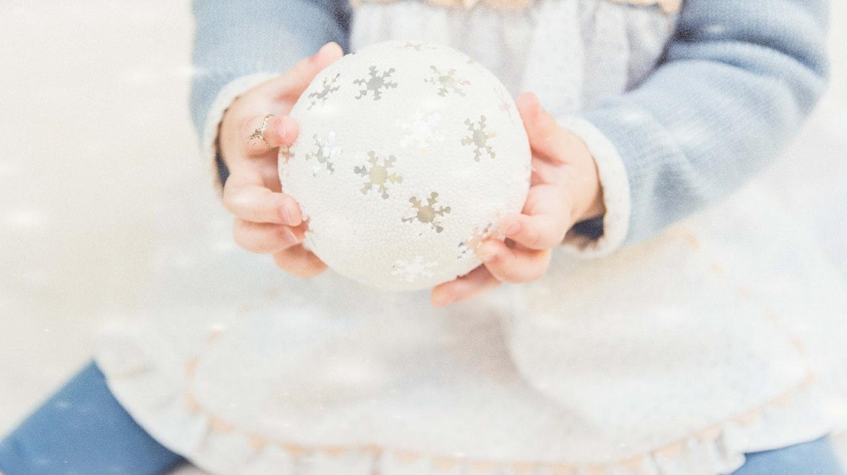
Want big celebration?
Use big image.

Slide 12
Use dashing charts to explain your ideas
Bells
Spirit
Carols

Slide 13
Maps
Santa Claus

Slide 14
89,526,124
Hugs & kisses

Slide 15
Our process is easy
Make gifts
Prepare sleigh
Deliver gifts

Slide 16
Let’s review some concepts
Apple cider
This untreated cider is a seasonally produced drink of limited shelf-life that is typically available only in fall, although it is sometimes frozen for use throughout the year.
Hot cocoa
Heated beverage typically consisting of shaved chocolate, melted chocolate or cocoa powder, heated milk or water, and sugar.
Pecan pie
Pecan pie is a pie made primarily with corn syrup and pecan nuts. Variations may include white or brown sugar, sugar syrup, molasses, maple syrup, or honey.
Apple cider
This untreated cider is a seasonally produced drink of limited shelf-life that is typically available only in fall, although it is sometimes frozen for use throughout the year.
Hot cocoa
Heated beverage typically consisting of shaved chocolate, melted chocolate or cocoa powder, heated milk or water, and sugar.
Pecan pie
Pecan pie is a pie made primarily with corn syrup and pecan nuts. Variations may include white or brown sugar, sugar syrup, molasses, maple syrup, or honey.

Slide 17
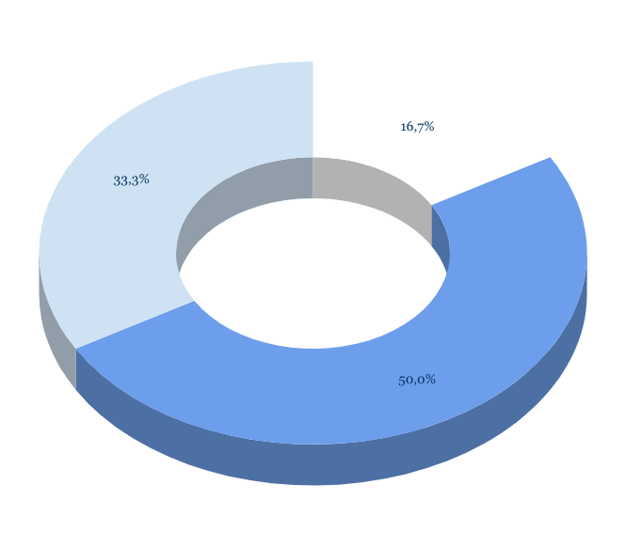
You can copy&paste wintry graphs from Google Sheets

Slide 18
Mobile project
Show and explain your web, app or software projects using these gadget templates.
Place your screenshot here

Slide 19
Tablet project
Show and explain your web, app or software projects using these gadget templates.
Place your screenshot here

Slide 20
Desktop project
Show and explain your web, app or software projects using these gadget templates.
Place your screenshot here

Slide 21
Merry Christmas
and a Happy New Year!
Find us at @northpole

Slide 22
Credits
As a Christmas gift, SlidesCarnival releases for free this template (and icons) under the public domain.
So there’s no need to keep this slide. :) Enjoy!
To the extent possible under law, http://www.slidescarnival.com has waived all copyright and related or neighboring rights to Christmas 2018 template

Slide 23
Presentation design
This presentations uses the following typographies:
Titles: Cinzel
Body copy: Nunito
You can download the fonts on these pages:
https://www.fontsquirrel.com/fonts/cinzel
https://www.fontsquirrel.com/fonts/nunito
You don’t need to keep this slide in your presentation. It’s only here to serve you as a design guide if you need to create new slides or download the fonts to edit the presentation in PowerPoint®

Slide 24
To the extent possible under law, http://www.slidescarnival.com has waived all copyright and related or neighboring rights to these Christmas Icons.

Slide 25
Diagrams and infographics

Slide 26
😉
Now you can use any emoji as an icon!
And of course it resizes without losing quality and you can change the color.
How? Follow Google instructions https://twitter.com/googledocs/status/730087240156643328
✋👆👉👍👤👦👧👨👩👪💃🏃💑❤😂😉😋😒😭👶😸🐟🍒🍔💣📌📖🔨🎃🎈🎨🏈🏰🌏🔌🔑 and many more...

Slide 27

Free templates for all your presentation needs
For PowerPoint and Google Slides
100% free for personal or commercial use
Ready to use, professional and customizable
Blow your audience away with attractive visuals

